Slide 1
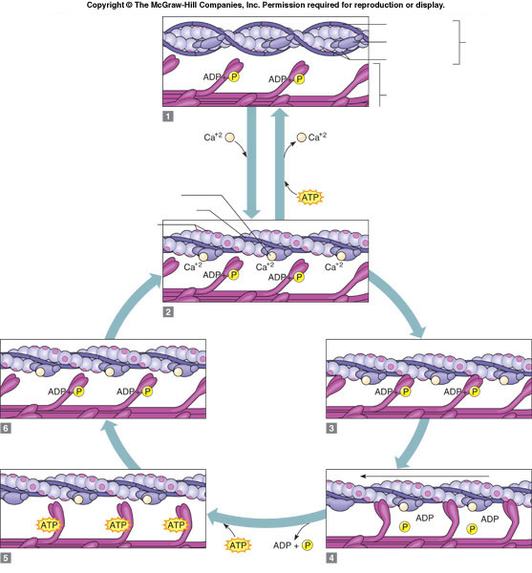
Activity: 5 pts
A
Q1: What is letter A?
Q2: What is letter B?
Q3:Explain event at Stage 2
Q4:Explain event at stage 5
Q5: Identify the power stroke
B
Stage 2
Stage 2
Stage 6
Stage 3
Stage 5
Stage 4
Notes:
Everyone who submits gets two points and then grade Q1, Q2 and A5.
Answers:
Letter A is Actin……1 pt
Letter B is myosin…...1 pt
Stage 2: Calcium binds to actin and opens up the binding site for myosin head. The muscle is getting ready to attach because the ATP has hydrolyzed to ADP and Pi
Stage 5: Myosin is detaching from actin
Power stroke is Stage 4….….1 pt

