Slide 2
Mutations

Slide 3
Objectives
To learn the 2 main types of mutations
Given a mutation, identify its type
Predict how a mutation will affect a protein.

Slide 4
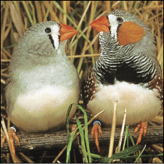
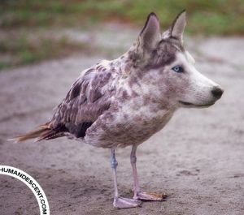
Mutations
Changes in genetic material (DNA)

Slide 5
2 main types of mutations
Point mutation- change in one or a few nucleotides (letters)
Chromosomal mutation- change in very large section of DNA

Slide 6
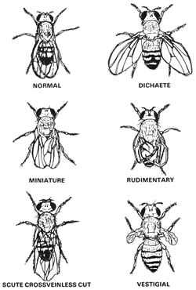
Types of Point Mutations
Substitution- one base is replaced with another
Normal: ATCG
Mutation: AGCG
2) Insertion- adds nucleotides
Normal: ATCG
Mutation: ATCCG
3) Deletion- takes them away
Normal: ATCG
Mutation: ATG

Slide 7
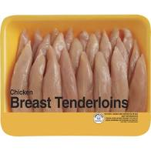
Examples

Slide 8
Frame Shift- when adding or deleting nucleotides changes the codon groupings

Slide 9
Sickle Cell Anemia causes red blood cells to be misshaped
Caused by a single base pair substitution
in the gene for hemoglobin,
which carries oxygen in the blood

Slide 10
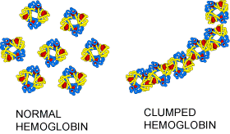
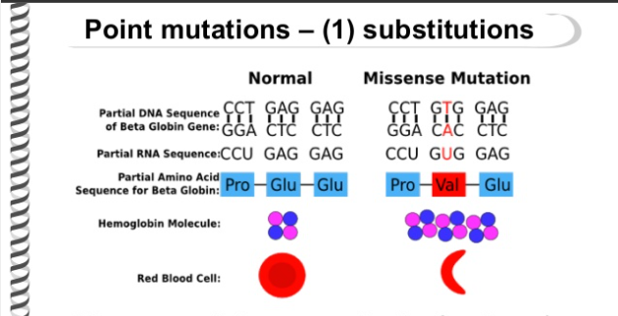
Sickle Cell Anemia

Slide 11
Also known as a substitution

Slide 12
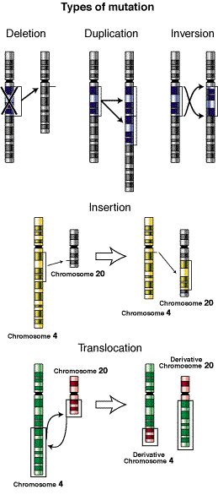
Chromosomal mutations
Changes in very large section of DNA
-more than one gene is
affected
Chromosome- very large piece of DNA
with many genes
Polyploidy- organism has
extra set of chromosomes

Slide 13
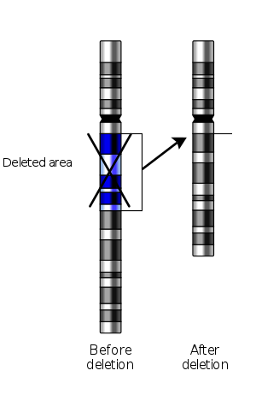
Deletion
Part of chromosome missing

Slide 14
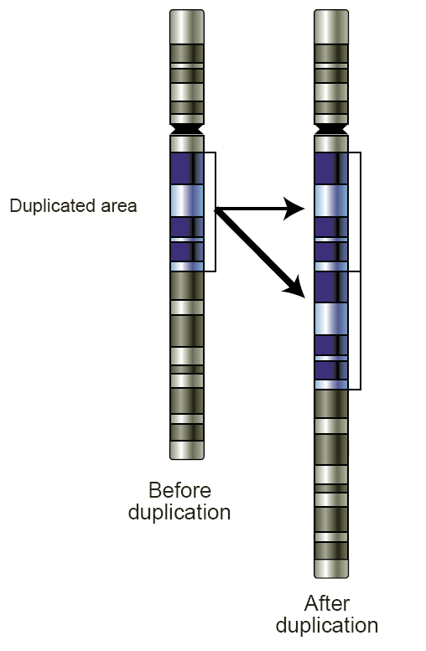
Duplication
Piece is duplicated

Slide 15
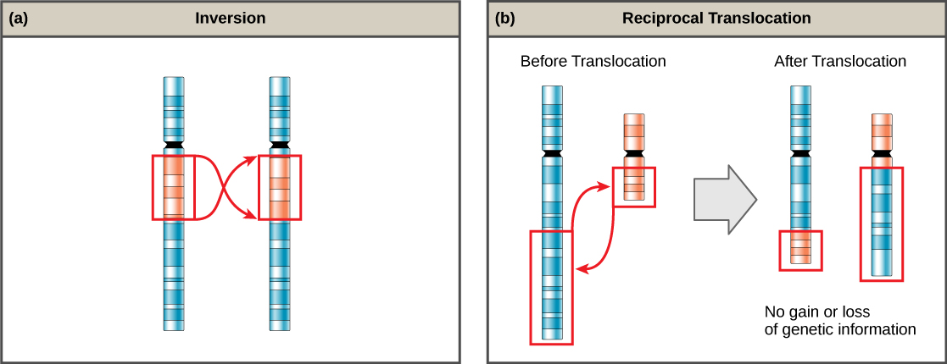
Inversion
Piece is added backwards

Slide 16
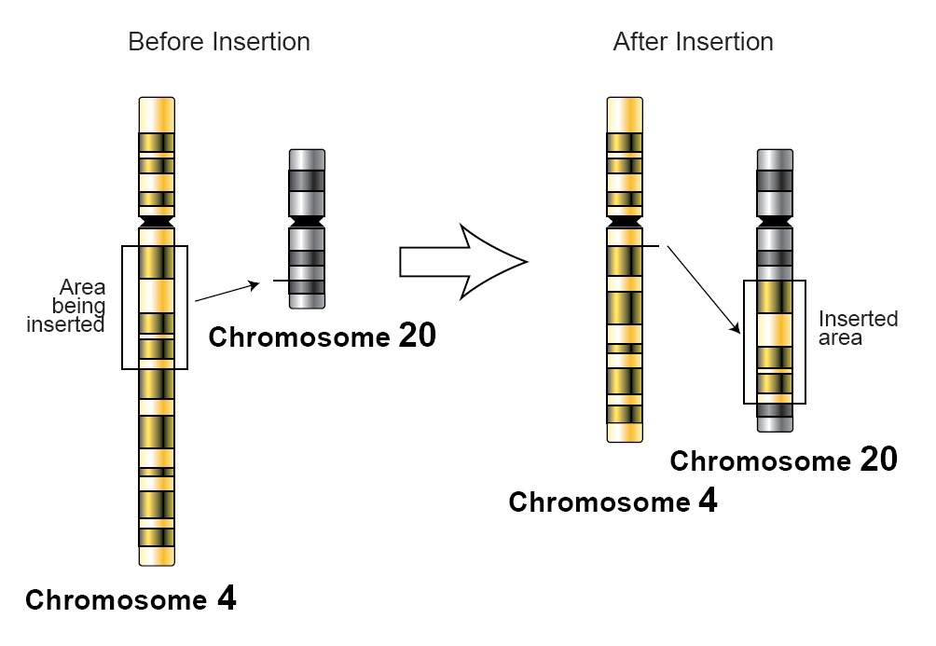
Insertion
Piece is added

Slide 17
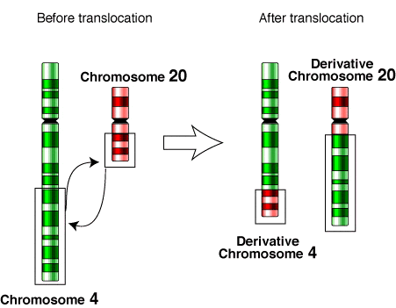
Translocation
Piece inserted in the wrong spot

Slide 18
Karyotype- image of the chromosomes in a cell
Cells that are not eggs and sperm
have 2 of each type of chromosome

Slide 19
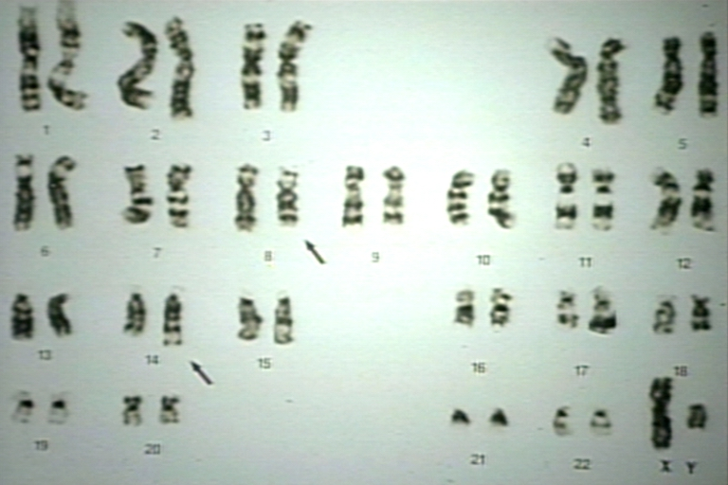
Abnormal karyotypes

