Slide 1
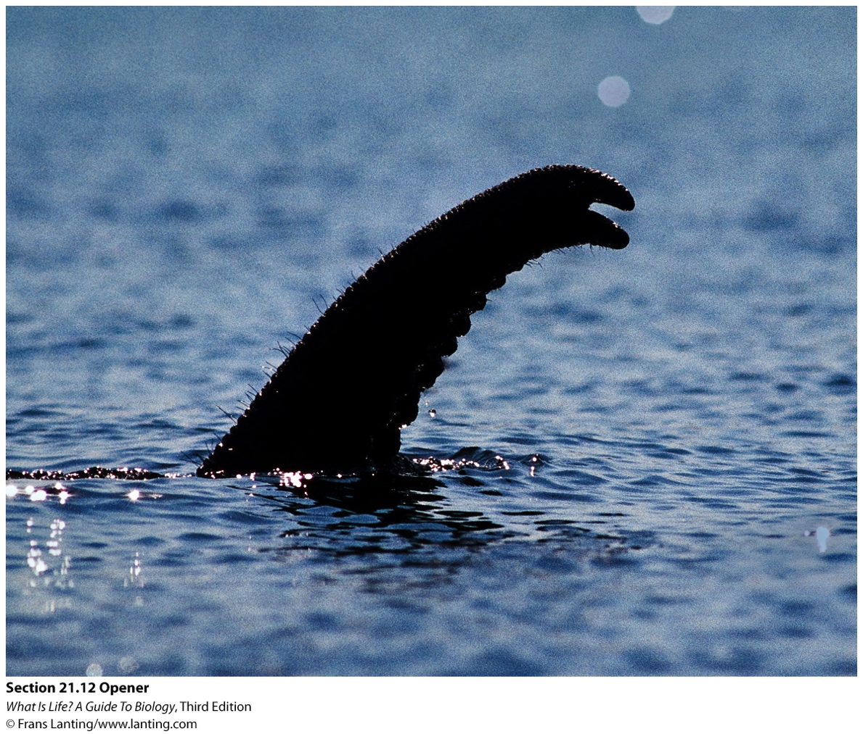
The respiratory system enables gas exchange in animals.

Slide 2
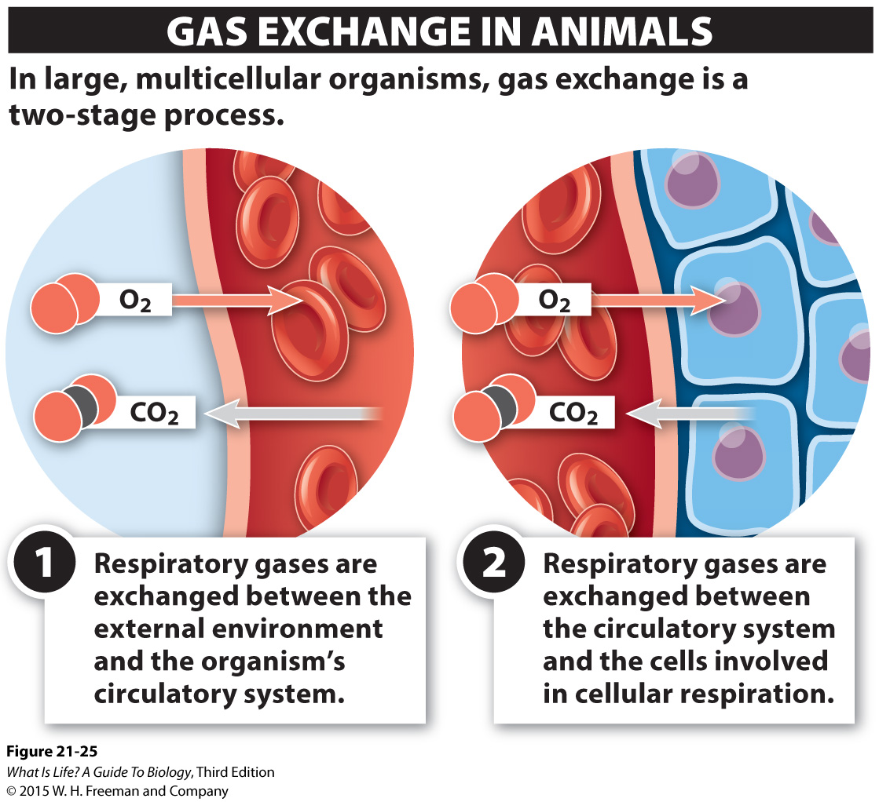
21.12 Oxygen and carbon dioxide must get into and out of the circulatory system.
Notes:
In single-celled and very small multicellular organisms, gas exchange can occur by direct diffusion. In larger multicellular organisms, however, gas exchange becomes a two-stage process. First comes the exchange between the external environment and the organism’s circulatory system. Later comes the exchange between the circulatory system and the cells involved in cellular respiration.

Slide 3
21.13 Oxygen is transported while bound to hemoglobin.
Notes:
Red blood cells are filled with a molecule called hemoglobin. Hemoglobin is like an oxygen “shuttle bus,” transporting oxygen around the body.
Hemoglobin is a tiny molecule—so tiny that there are about 250 million copies of it in every single red blood cell. Built right inside the blood cell, the hemoglobin remains there for the cell’s entire life. Each molecule of hemoglobin is a tangled mass of four polypeptide chains. Nestled within the molecule are four cozy compartments, each of which can carry one molecule of oxygen gas on a seat of iron. This iron attaches to the O₂ that diffuses into the red blood cell, temporarily making it part of the hemoglobin molecule.
As we discussed earlier, a shortage of iron in your diet can lead to anemia. This is because when iron is in short supply, less oxygen can be bound by hemoglobin and transported by each red blood cell, causing muscles and organs to be starved of oxygen and leading to feelings of fatigue and weakness.

Slide 4
Notes:
Figure 21-30 shows an oxygen binding curve for hemoglobin, illustrating the relationship between the amount of oxygen (measured as its PO₂) and the proportion of oxygen molecules that hemoglobin holds onto.

Slide 5
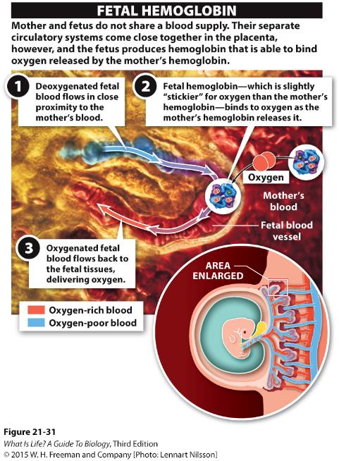
Notes:
When a woman is pregnant, the growing fetus does not breathe air. This does not mean that the fetus doesn’t need oxygen, however. During development, oxygen needs are actually very high. How does a fetus get the O₂ it needs? It has to scavenge oxygen molecules released by the mother’s hemoglobin. Fetuses do this by producing their own special type of hemoglobin that is a bit stickier than normal adult hemoglobin. At a PO₂ that is low enough for the mother’s hemoglobin to release oxygen, the fetal hemoglobin—with its greater stickiness (or oxygen affinity)—binds to the oxygen. It then can deliver that oxygen to its own, fetal tissues (Figure 21-31).

Slide 6
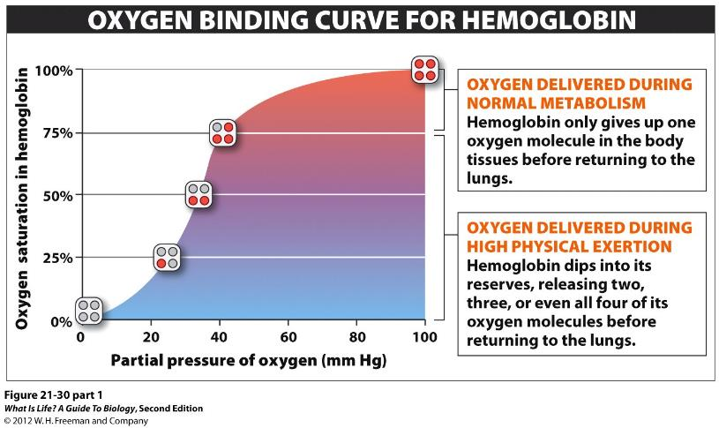
What is the O₂ saturation of hemoglobin at a PO₂ of 60mmHg?
~60%
~75%
~90%
~100%
Notes:
Answer: C
It is not 75% or 100% because the data is based on more than one hemoglobin molecule

Slide 7
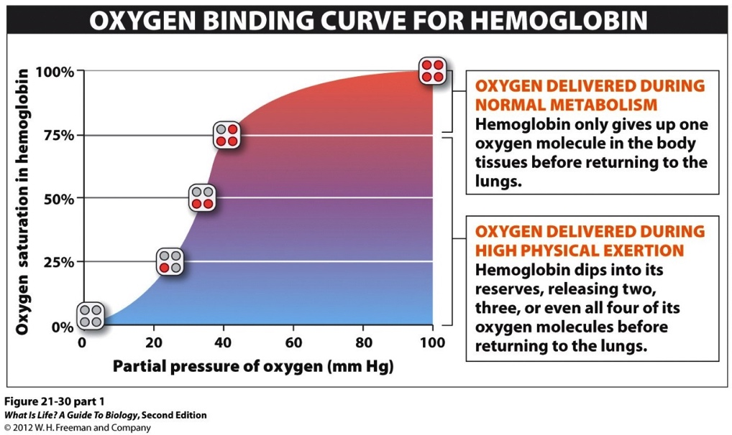
What is the significance of the curve’s “s” shape?
A. An inverse relationship exists between O₂ saturation and PO₂.
B. A linear relationship exists between O₂ saturation and PO₂.
C. A nonlinear relationship exists between O₂ saturation and PO₂.
D. Both A and C.
Notes:
Answer: C

Slide 8
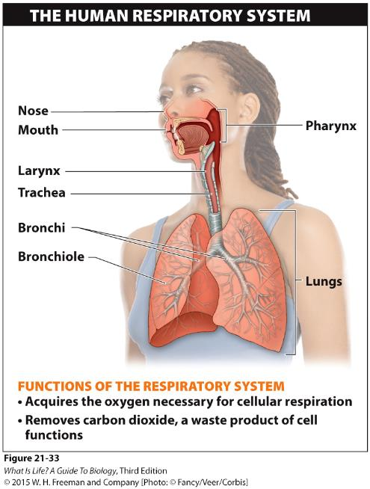
Respiratory systems of terrestrial vertebrates move oxygen-rich air into the lungs and carbon-dioxide-rich air out of the lungs
Notes:
Life on land is very different from life underwater, but the fundamental energetic needs remain. ATP is still the chemical that provides the energy for all the reactions necessary for life, and cells still need oxygen to produce ATP. Consequently, an organism must put air in contact with the cells that need it. Ultimately, oxygen must get into the cells and carbon dioxide must get out. These are universal challenges facing all terrestrial animals.
Mammalian respiration begins with a deep breath. Let’s trace the air through the respiratory process (Figure 21-33).
Air enters through the nose, filling the nasal cavity, where it becomes warm and moist. Additional air can be taken in through the mouth. In either case, these two entry points for air join together at the throat (also called the pharynx), at the back of the mouth. The air passes through the throat and moves through the voice box, or vocal cords—also called the larynx. The voice box can be seen as the bump on the front of your neck, called the “Adam’s apple.” From the larynx, the air moves into the trachea (also called the windpipe), a long tube that takes the air into the chest cavity. Once there, the trachea branches into two smaller tubes called bronchi. One bronchus goes to the left lung, and the other goes to the right lung.

Slide 9
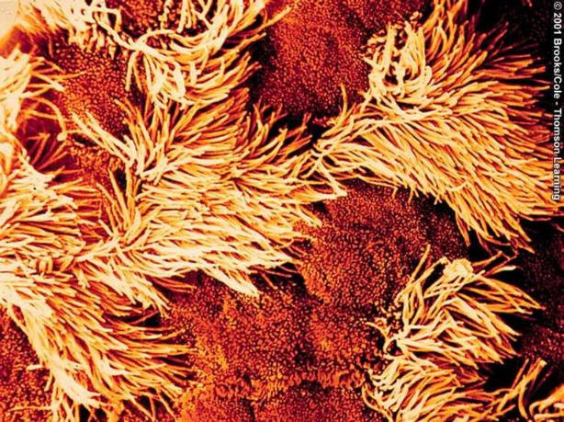
Respiratory Passages are lined with mucous membranes and cilia
Ciliated cells and mucus cells are epithelial cells !!
Ciliated Cells
Mucus-Secreting
Cells
Notes:
The cilia move and push the mucus (which has the trapped dust and microorganisms) out of the airways.
Smoking paralyzes the cilia and the without the action of cilia, mucus and trapped particles pool in the airways. Bacteira trapped in the mucus can multiply and cause respiratory infections.

Slide 10
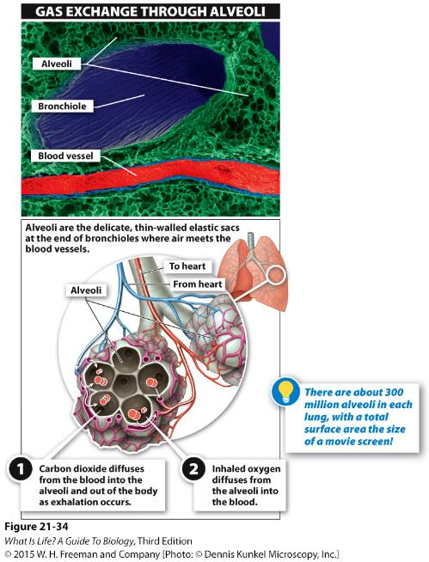
Notes:
When the bronchi enter the lungs, which are like stretchy, elastic bags, they branch again. And again. And again. With each successive branching, the bronchi get smaller. Under a certain size they are called bronchioles. And they all just keep branching and spreading out. Eventually, the bronchioles reach a dead end. These dead ends are tiny elastic sacs, the alveoli, and it is here that the air meets the blood vessels.

Slide 11
Which structure in the lung facilitates direct exchange of gases with the circulatory system?
A. trachea
B. bronchi
C. bronchiole
D. alveoli
E. All of the above.
Notes:
Answer: D

Slide 12
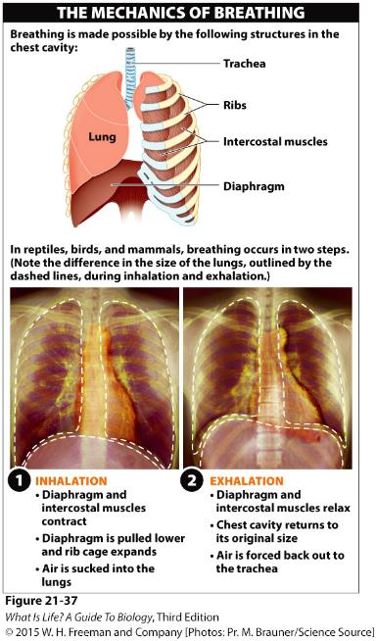
Muscles control the flow of air into and out of the lungs.
Notes:
In reptiles, birds, and mammals, breathing occurs in two steps: inhalation and exhalation. The chest cavity is bordered on the bottom by a large sheet of muscle called the diaphragm, which separates the chest cavity from the abdominal cavity. The rest of the chest cavity is surrounded by the rib cage and the intercostal muscles between the ribs. During inhalation, the diaphragm and external intercostal muscles contract; the diaphragm is pulled down, and the intercostal muscles lift the ribs and expand the rib cage. This causes a rapid increase in the volume of the chest cavity and lungs, which causes air to be sucked into the lungs. When the diaphragm and intercostal muscles relax, the chest cavity returns to its original size. This reduction in volume compresses the lungs and forces air back out.

Slide 13
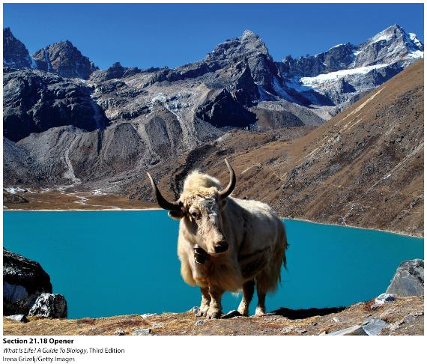
Evolutionary adaptations maximize oxygen delivery.
Notes:
A rare white yak near Goyko Lake, in the Himalayas, almost 5,000 m above sea level.
One of the most important constraints on the rate at which oxygen diffuses into the blood is air pressure. At high altitudes, much less oxygen is available. With lower pressure from above, less oxygen is squeezed into a given volume. The lower air pressure makes it hard to push air into lungs and to drive the oxygen across the alveolar and capillary membranes and into the blood. We struggle at high elevations, because our hemoglobin isn’t designed to pick up oxygen at such a low pressure; the hemoglobin isn’t sticky enough.

Slide 14
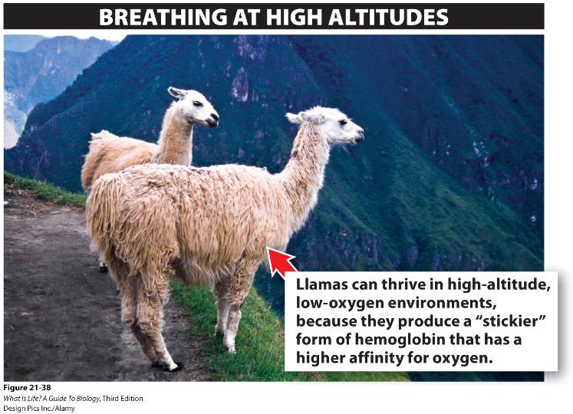
Adaptations to Low Partial Pressure
of Oxygen
Notes:
Animals, such as the llamas seen here, live at high altitudes, an environment that is oxygen poor due to a decrease in total air pressure. At high elevations, the amount of oxygen present is lower, and breathing and activity are difficult.
Animals living at high elevations solve this problem by producing a form of hemoglobin that has a higher affinity for oxygen.
In this situation, the adult human hemoglobin would never pick up all four oxygen molecules as it circulated through the lungs. Llamas, however, produce a stickier form of hemoglobin, similar to the strategy used by the human fetus, that can obtain a full complement of oxygen at a low partial pressure of oxygen.

Slide 15
Which are the main muscles used in breathing
Back and thoracic muscles
Diaphragm and thoracic
Diaphragm and intercostal muscles
Diaphragm and back muscles
Notes:
Ans: c

Slide 16
Humans become acclimated to low-oxygen conditions.
Notes:
Although llamas are adapted for high elevations from the day they are born, most humans are not—but we acclimate well, and this has a significant impact on our strength, speed, and stamina.
Training for three to five weeks at high elevations, usually 6,000–7,000 feet above sea level, triggers several physiological changes—a process called acclimation.
And, as with llamas, some of the human acclimation to low-oxygen conditions comes from modifications (though they are acquired rather than inherited) to hemoglobin.
High-elevation training causes an increase in a chemical called diphosphoglyceric acid (DPG) in red blood cells. This acid combines with hemoglobin in the red blood cells and alters the protein’s shape ever so slightly. In doing so, it reduces hemoglobin’s stickiness, giving it a lower affinity for oxygen. With this reduced oxygen affinity, the DPG-modified hemoglobin releases—at any elevation—more of the O₂ that it carries.
Humans living at high altitudes become acclimated to low-oxygen conditions over the course of three to five weeks.
This acclimation includes increasing the production of diphospholglyceric acid (DPG) in red blood cells and thereby reducing hemoglobin’s affinity for oxygen, leading to release of higher levels of oxygen to muscles during exertion

Slide 17
Notes:
Oxygen reserves. Myoglobin is a protein in muscles that stores oxygen for times of extreme exertion.

Slide 18
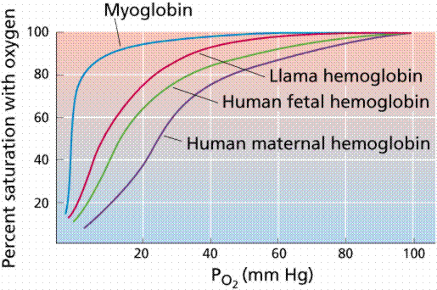
Which has the highest affinity for oxygen?
Human maternal hemoglobin
Human fetal hemoglobin
Llama hemoglobin
Myoglobin
Notes:
Ans: D

Slide 19
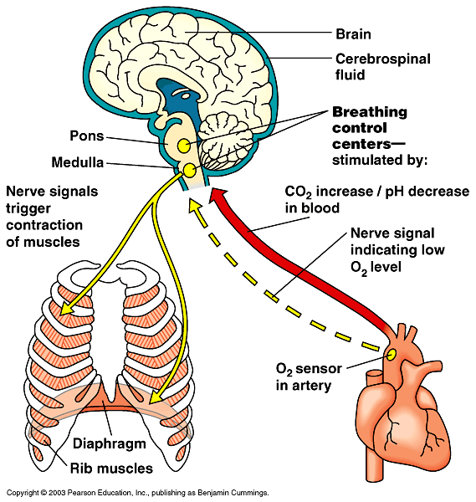
Control centers in brain stem regulate respiration rate
Phrenic Nerve
Notes:
More activity, more co2, more acid, less ph, chemoreceptors in carotid arteriers detect this and signal the brain.

Slide 20
Acclimation involves:
A. increased affinity of hemoglobin to oxygen.
B. a decrease in mitochondrial number.
C. DPG-modified hemoglobin releasing more O₂ to the tissues.
D. decreased red blood cell production.
E. All of the above.
Notes:
Answer: C

