Slide 1
Learning Objectives
Know the general structure of a virus and the structure of Sars-CoV 2 virus
Describe the process of viral infection and replication.
Understand the concerns with certain viruses being able to cross species boundaries to cause infection.
Explain the life cycle of the HIV virus.
Know the difference between vaccines and antivirals

Slide 2
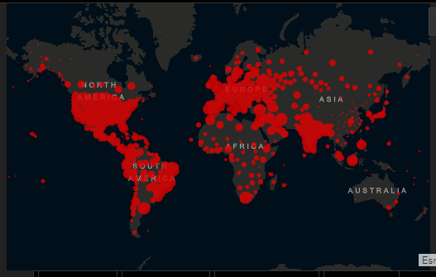

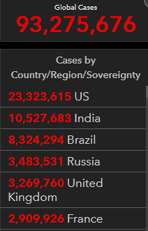
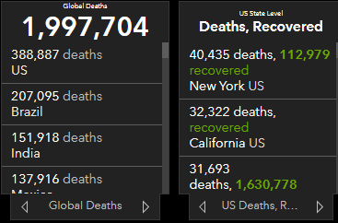
COVID-19
Originated in
Wuhan, China
https://coronavirus.jhu.edu/map.html
Notes:
According to Guan Yi, a virologist based in Hong Kong, the trajectory of the Wuhan virus parallels the early spread of SARS, the virus that spread to 29 countries, sickened thousands and killed 774 people in 2002 and 2003. The Chinese authorities on Thursday Jan 23morning closed off Wuhan — a major port city of more than 11 million people and the center of a respiratory virus that has spread all the way around the world — by canceling flights and trains leaving the city, and suspending buses, subways and ferries within it.
Since then, the covid-19 virus has
The Asian flu and Hong Kong flu pandemics also originated in Asia, as have smaller viral outbreaks, such as Korean flu (1947), swine fever (1976), and the SARS virus (2002−2003), which did not become pandemics.
Swine flu: 2009, MERS (middle eastern resp. syndrome) 2012 first in Saudi arabia
Figure 13-25 part 2 Viral outbreaks can threaten large populations. In 2002−2003, the virus that causes severe acute respiratory syndrome (SARS) infected several thousand people around the world.

Slide 3
Some COVID symptoms
Lungs: Inflammation, which damage lung cells and blood vessels.
Eye, Nose and Throat: Runny nose and conjunctivitis,
Heart: Inflammation of the heart lining, heart attacks and abnormal heart rhythms.
Nervous system: Loss of smell and taste; seizures, strokes and hallucinations
Kidneys
Diarrhea
.

Slide 4
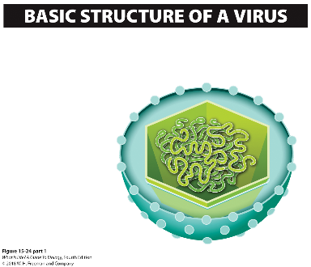
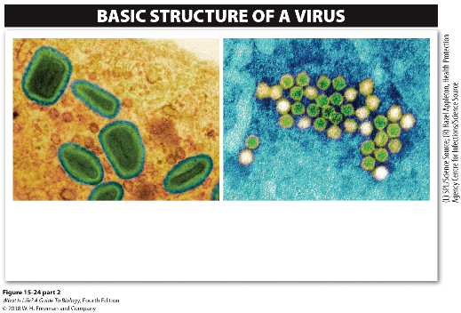
15.16 Viruses are not exactly living organisms.
All viruses have a container (the capsid) that holds their genetic material, and sometimes the capsid is wrapped in a membrane (an envelope).
Capsid
Capsid (container made of protein)
Plasma membrane
Genetic material (DNA or RNA)
Plasma membrane (envelope)
ENVELOPED VIRUS
Enveloped viruses wrap themselves in a bit of the plasma membrane of the host cell as they are released.
NON-ENVELOPED VIRUS
Non-enveloped viruses are enclosed only by a capsid.
Glycoproteins
Viruses are not cells and do not fit into any of the three domains of life.
Notes:
A virus particle (called a virion) consists of genetic material inside a container made of protein. Some viruses also contain a few enzymes. That’s all there is to a virus. The protein container is called the capsid, and the genetic material can be either DNA or RNA. Some viruses wrap themselves in a bit of the plasma membrane of the host cell as they are released. A virus of this type is called an enveloped virus—the flu virus is an example.
Non-enveloped viruses are enclosed only by the protein container; the virus that causes the common cold is an example of a non-enveloped virus.
There is almost nothing inside the capsid of a virus except DNA or RNA. A virus particle does not carry out any metabolic processes, and it does not control the inward or outward movement of molecules to make conditions inside the virus particle different from conditions outside. Viruses just wait for a chance to insert their genetic material into a living cell.
4

Slide 5
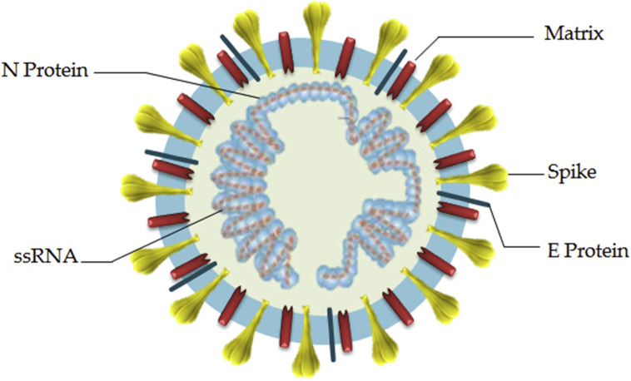
SARS-CoV-2
Capsid
Membrane
M protein
Genetic material
Notes:
S : spike protein
N: Nuclecapsid protein
E: small protein
M: membrane protein
The nucleocapsid known as N protein is the structural component of CoV localizing in the endoplasmic reticulum-Golgi region that structurally is bound to the nucleic acid material of the virus. Because the protein is bound to RNA, the protein is involved in processes related to the viral genome, the viral replication cycle, and the cellular response of host cells to viral infections [^{12,13}]. N protein is also heavily phosphorylated and suggested to lead to structural changes enhancing the affinity for viral RNA
Another important part of this virus is the membrane or M protein, which is the most structurally structured protein and plays a role in determining the shape of the virus envelope. This protein can bind to all other structural proteins

Slide 6
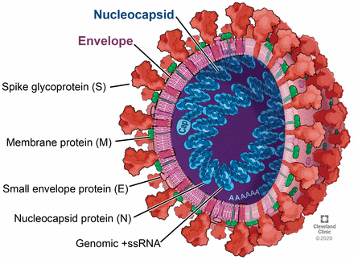
https://www.youtube.com/watch?v=8hgc2iZflTI

Slide 7
Viruses are ….
A. Protein coats that contain DNA or RNA
B. Simple eukaryotic cells
C. Simple prokaryotic cells
D. alive
Notes:
Ans: A

Slide 8
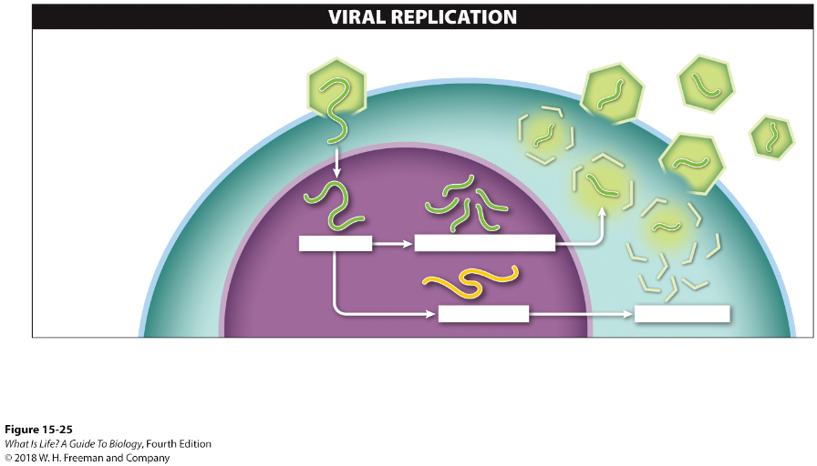

Viral Replication
After the virus binds to the host cell’s membrane, the viral DNA enters the cell.
Viral DNA is replicated into dozens of new copies, using the host’s metabolic machinery and energy.
Viral mRNA is transcribed from the viral DNA.
New viral proteins are synthesized, again using the host’s protein- production molecules.
The new viral DNA and proteins assemble, forming many new virus particles.
Virus
1
1
Host cell
2
5
Host nucleus
3
2
4
Viral DNA
Replicated viral DNA
3
4
5
Viral mRNA
Viral proteins
Because they are dependent on their hosts’ metabolic machinery for replication, viruses are not considered “living.”
Notes:
We speak of “catching” a cold, but in reality, a virus catches us. Viruses identify the cells that they can infect by the specific glycoprotein molecules on the surfaces of those cells. Every cell in your body has glycoprotein molecules that are embedded in the plasma membrane and extend outward. Your immune system uses these proteins to identify the cells as part of you. When viruses find a cell with the appropriate glycoprotein on its surface, they bind to that cell’s plasma membrane and insert their genetic material into the cell (Figure 15-25). The viral DNA or RNA takes over the cellular machinery and uses it to produce more viruses.
Viruses carry out most activities by hijacking materials and organelles in the host cell. Viral proteins are synthesized in the same way as host cell proteins—mRNA binds to the cell’s ribosomes, and tRNA matches the correct amino acid to each mRNA codon. The mRNA is produced from the virus’s DNA or RNA, but all the protein-building machinery comes from the host cell, as does the ATP required to synthesize the new viral protein.
8

Slide 9
Other Types of Non-Living Infectious Agents
Prions are misfolded proteins.
  Usually acquired through ingestion of an infected animal
  Cause degenerative neurological diseases in humans
  Creutzfeldt-Jakob disease
  “Mad cow disease”
  No known cure or treatment
Notes:
Besides viruses, there are some other types of non-living infectious agents. Prions, for example, are misfolded proteins that form plaques and interfere with normal tissue. Usually acquired through ingestion of an infected animal (or its bodily fluids), prions can cause a variety of degenerative neurological diseases in humans. One of these, Creutzfeldt-Jakob disease, is sometimes referred to as a human form of mad cow disease: it is characterized by the development of holes in brain tissue, causing the tissue to appear sponge-like. It leads to dementia, memory loss, and disruption of balance and coordination. No cure or treatment is known, and few victims survive more than a year following the appearance of symptoms.

Slide 10
Take Home Message 15.16
A virus is not alive, but it can carry out some of the same functions as living organisms if it can get inside a cell.
A virus takes over the protein-making machinery of the host cell to produce more viral genetic material (RNA or DNA) and protein.
The viral proteins and genetic material are assembled into new virus particles and released from the cell.

Slide 11
15.17 Viruses are responsible for many health problems.
Many diseases are caused by viruses.
  Influenza
  HIV/AIDS
  Common cold
  Herpes
DNA viruses
  Vaccines may be developed to fight infection.
RNA viruses
  Mutate rapidly
Notes:
Many diseases are caused by viruses. Some viral diseases have been responsible for worldwide epidemics, called pandemics. The influenza pandemic of 1918–1919 killed at least 20 million people, and possibly as many as 50 million. In the current HIV/AIDS pandemic, more than 75 million people have been infected and about 35 million people have died of AIDS. Worldwide, about 1.1 million people died of AIDS-related illnesses in 2015.
Other viral diseases, such as the common cold, are not usually serious.
Herpes is another common viral infection in humans, caused by two related viruses. Oral herpes is an infection near the mouth and can cause cold sores lasting two to three weeks. More than three-quarters of all adults in the United States are infected with the virus, with more than 50 million people experiencing outbreaks each year.
Genital herpes, a sexually transmitted disease, affects about one in six people between the ages of 14 and 49 in the United States. The viruses causing herpes are present in and released from sores and spread by skin-to-skin contact, but an infected person can also pass on the virus even when she or he has no symptoms. Although a variety of treatments are available for both types of herpes, including antiviral drugs that can reduce the severity and duration of symptoms, there is currently no cure.
DNA viruses have base-pair sequences that are stable over time, because the enzymes that replicate the DNA check for errors and correct them during replication. From a health perspective, the fact that DNA viruses do not change rapidly makes it much easier to fight and treat diseases caused by these viruses, using vaccines. Vaccination against a DNA virus such as smallpox, for example, provides years of protection.
RNA viruses, by contrast, change quickly, because the enzymes that carry out RNA replication do not have error-checking mechanisms. Because the RNA-replicating enzymes make errors as they assemble new RNA molecules, RNA viruses are continuously mutating into new forms. The common influenza virus that causes outbreaks of flu every year, for example, is an RNA virus. Flu viruses mutate so fast that the virus changes from one flu season to the next, necessitating a different flu vaccine every year.
11

Slide 12
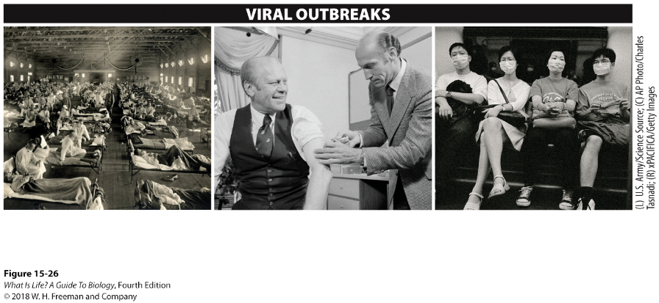
Pandemics
World-wide epidemics of disease outbreak
The influenza pandemic of 1918–1919 killed millions.
President Gerald Ford receives the swine flu vaccine in the White House in 1976.
In 2002–2003, the virus that causes severe acute respiratory syndrome (SARS) infected several thousand people around the world.
Notes:
About every 50 years, a new variety of influenza causes a pandemic. The 20th century had three major influenza pandemics. In each case, a bird flu virus gained the ability to infect human cells by passing through pigs, and then the virus spread rapidly through the human population worldwide.
The most famous of these pandemics was that of 1918–1919, mentioned above (Figure 15-26). It was called the Spanish influenza, because it seemed to enter Europe through Spain, but it originated in Asia. The influenza pandemic of 1918–1919 killed at least 20 million people, and possibly as many as 50 million.
The Asian flu and Hong Kong flu pandemics also originated in Asia, as did smaller viral outbreaks, such as Korean flu (1947), swine fever (1976), and SARS (severe acute respiratory syndrome, 2002–2003), which did not become pandemics.

Slide 13

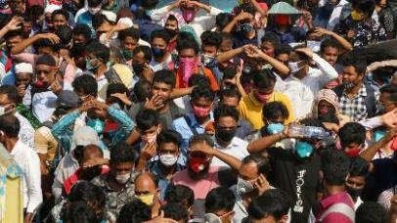


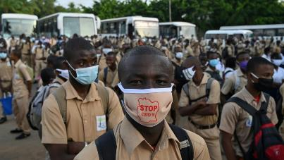

Coronavirus Pandemic
2019
Russia
Bangladesh
US
Australia
Italy
Africa

Slide 14
Take Home Message 15.17
Many diseases are caused by viruses.
DNA viruses are relatively stable, because DNA-replicating enzymes check for errors and correct them during replication.
RNA viruses change quickly, however, because RNA replication enzymes do not have error-checking mechanisms.

Slide 15
Viruses that have ___ as their genetic material make vaccination futile.
A. Glycoproteins
B. Reverse transcriptase
C. DNA
D. RNA
Notes:
Ans: D

Slide 16
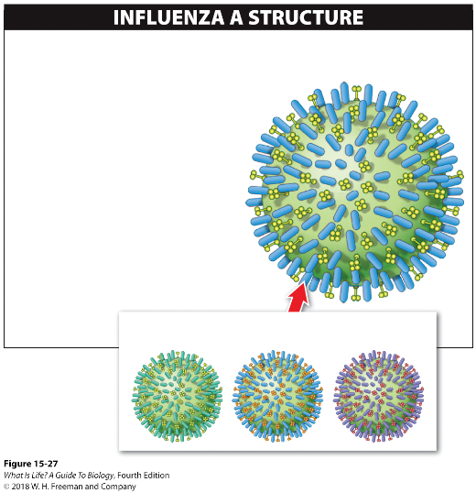
15.18 Viruses infect a wide range of organisms.
Glycoproteins on the surface of a virus determine:
  which host species the virus can infect
  which tissues of the host it can enter
The influenza virus has surface glycoproteins that allow it to bind to and exit a host cell.
SURFACE GLYCOPROTEINS
Bind to receptors on the surface of the host cell and allow the virus to enter
Allow the virus to break free from the host cell
A virus can have multiple strains, each with a different set of surface glycoproteins:
Notes:
Viruses are nearly everywhere. Viruses infect animals and plants, and even infect bacteria. Most viruses infect just one species, or only a few closely related species, and enter only one kind of cell in that species.
But some viruses can infect a wide range of hosts—the rabies virus, for example, can infect any mammal. Pet dogs and cats are routinely immunized against it, but wild mammals, such as bats, skunks, and raccoons, can get rabies. That is why, if you are bitten by one of those wild animals, your treatment includes rabies shots as a precaution.
The glycoproteins on the surface of a virus determine which host species the virus can infect and which tissues of the host it can enter. Influenza A viruses (the ones that cause flu outbreaks every year), for example, have two types of glycoprotein that have different functions. One glycoprotein matches that of a host cell and allows the virus to enter the cell. The other glycoprotein allows virus particles to get back out of the cell—new virus particles that can infect other cells.
16

Slide 17
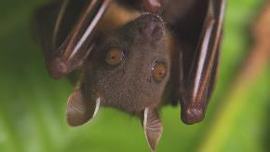
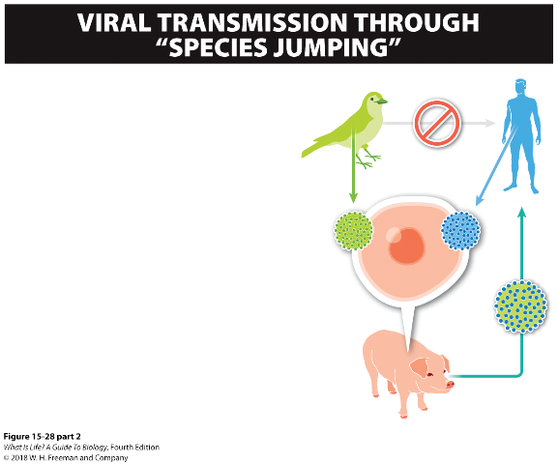
Viral Transmission between Species
Viruses that infect birds don’t bind well to glycoproteins in human cells, making it difficult for bird viruses to infect humans
Most scientists think that Covid 19 originated in bats and jumped into the human population
However, a virus that infects humans and a virus that infects birds can meet, if both have infected a pig cell.
Because viral RNA replication is error-prone, the two viral RNA molecules can get packaged together into a new virus particle. The new virus can have features from the bird virus and be capable of infecting humans.
Latest on the research into Covid 19 origin:
https://www.who.int/emergencies/diseases/novel-coronavirus-2019/media-resources/science-in-5/episode-21---covid-19---origins-of-the-sars-cov-2-virus
Notes:
Influenza A is an example of a virus that can move from one species to another, and as we noted, all influenza pandemics in the past century began when a bird flu virus infected humans.
Here’s how “species jumping” can occur. Viruses that infect birds don’t bind well to glycoproteins in human cells, making it difficult for bird flu viruses to infect humans. However, the cells of pigs have glycoproteins that allow both human and bird flu viruses to bind to them.
Thus, a pig cell can be infected by a human flu virus and a bird flu virus at the same time. But influenza viruses are not very careful when they incorporate newly synthesized RNA into new particles. If RNA strands from a human flu virus and a bird flu virus happen to be in a pig cell at the same time, some virus particles released from the cell might include RNA from both the bird and the human virus. These influenza viruses are a new strain, and they may be able to infect humans.
Since 1997, one strain of bird flu has spread from Hong Kong through most of Asia and into Turkey, France, Germany, and England. This avian influenza virus can also infect humans, not needing pigs as intermediary. The virus readily infects birds, and tens of millions of chickens, turkeys, and ducks have been killed in attempts to eradicate the infection. Because the virus’s host-entry glycoproteins do not bind well to human cells, the virus does not easily infect people and spread from human to human.
So far, nearly all of the people infected by the avian influenza virus have gotten it through close contact with infected flocks of birds or by eating birds that died of the viral infection. Only a half-dozen cases are known in which the virus seems to have been transmitted from one person to another. However, avian flu can be
deadly when it does infect humans—more than half of the 650 human cases reported as of 2014 have ended in death.
Covid 19 is believed to have originated in bats. The WHO is sending a team to Wuhan to study exactly how this occurred. Transmission of viruses from bats to humans is not new. A 2017 study of 12 333 bats from Latin America, Africa, and Asia found that almost 9% carried at least one of 91 distinct coronaviruses.
17

Slide 18
Take Home Message 15.18
Glycoproteins on the surfaces of viruses determine the types of cells a virus can invade.
Most viruses infect just one species, or only a few closely related species, and enter only one kind of cell in that species.

Slide 19
If the bird flu virus can enter a pig cell, then the pig cell must have ____ that allow the bird flu virus to enter the cell.
A. Cell membrane
B. Capsid
C. Glycoproteins
D. All of the above
Notes:
Ans: C

Slide 20
15.19 HIV illustrates the difficulty of controlling infectious viruses.
Human immunodeficiency virus (HIV)
Acquired immunodeficiency syndrome (AIDS)
  HIV causes AIDS
HIV has hallmark qualities that make viral diseases hard to control.
Notes:
New infectious diseases—some caused by bacteria and others by viruses—emerge quite frequently. Many diseases originate in an animal and subsequently acquire the ability to infect humans. There are enough of these new diseases to fill the monthly issues of the journal Emerging Infectious Diseases, which is published by the Centers for Disease Control and Prevention. Even so, acquired immunodeficiency syndrome (AIDS) stands out. AIDS is caused by the human immunodeficiency virus (HIV), which is derived from a strain of the simian immunodeficiency virus (SIV) that jumped from chimpanzees to humans in the early 1900s. HIV has the hallmark qualities that make viral diseases hard to control—plus an additional characteristic of its own.
20

Slide 21
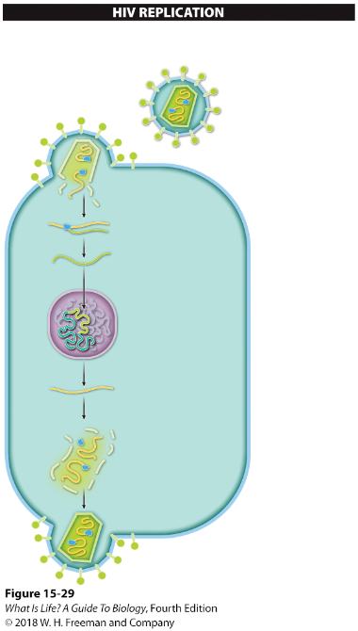
HIV mutates easily.
The HIV particle carries its genetic instructions in the form of RNA rather than DNA. The virus takes over a white blood cell’s replicating machinery to produce a new generation of HIV particles.
RNA (two identical strands)
Reverse transcriptase
Surface glycoproteins
HIV is a retrovirus—an RNA-containing virus that contains reverse transcriptase.
Reverse transcriptase is error-prone.
Viral RNA
Host cell
1
An enzyme carried within the HIV particle converts the viral RNA into DNA once inside the infected cell. (Making DNA from RNA is like transcription in reverse, so the enzyme is called reverse transcriptase.)
The newly produced DNA, based on the code carried by the HIV particles, is inserted into the host’s DNA.
The host cell then transcribes the genes from HIV, much like it transcribes other genes. But these genes code for the production of new virus particles.
The new virus particles are assembled and released from the host cell.
Reverse transcriptase
Viral DNA
Host nucleus
Host DNA
2
New viral RNA
3
New viral proteins
4
Notes:
1. HIV mutates easily. HIV is a retrovirus, an RNA-containing virus that also contains a viral protein called reverse transcriptase, an enzyme that uses a strand of viral RNA as a template to synthesize a single strand of DNA. That DNA strand, in turn, is used as a template to make a complementary strand of DNA, and the resulting double-stranded DNA is integrated into the host cell’s DNA. From here, the DNA is used by the host cell’s machinery to make more viral RNA.
Reverse transcriptase is so error-prone, however, that virtually every copy of HIV in an infected individual’s body has a different mutation.
This enormous genetic variation in the HIV particles circulating in an infected person’s body makes the infection hard to treat. Virus particles with different mutations can have different proteins on their surfaces, and these surface proteins change each time the virus replicates inside a host cell. Each new generation of HIV in the infected individual contains viruses with surface proteins that his or her immune system has never seen. Furthermore, some of the HIV mutations confer resistance to the drugs that are being used to treat the patient, and new drugs must be used.
21

Slide 22
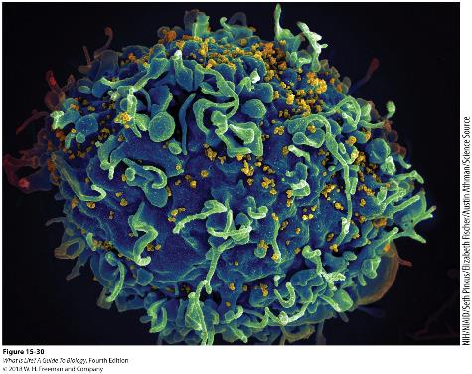
HIV attacks white blood cells.
HIV attacks white blood cells essential for identifying foreign invaders.
Ultimately, the immune system collapses.
Notes:
2. HIV attacks white blood cells. All of those problems would apply to any disease caused by a retrovirus but HIV offers an additional challenge: it targets cells in the host’s immune system, especially white blood cells, and particularly those that search for and attack invading bacteria or viruses.
During the incubation period, which can last for many years, HIV infects white blood cells. New ones are produced to replace those killed by the virus so that the infected person has virtually no symptoms. Nonetheless, HIV is present in the individual’s body fluids during the incubation period and can be transmitted to other individuals. HIV testing is used to detect infections during this stage.
Each time HIV infects another white blood cell, the reverse transcriptase makes errors in transcribing the RNA to DNA, and eventually one of the mutations allows the virus to bind to the glycoprotein on the surface of a specialized type of white blood cell—a bacteria- and
virus-hunting—white blood cell that is critically important in identifying disease-causing threats.
A suitable mutation may occur in a couple of years, though more often it takes about 10 years or longer. But when it does happen, it signals a new stage in the HIV infection: the development of AIDS.
3. The immune system collapses.
Normally, white blood cells all work together to identify and destroy cells that have been infected by a virus. When HIV begins to kill the cells that hunt for viruses and bacteria, the immune system begins to fail—it can no longer respond to HIV, or to any other infectious agent. Patients with AIDS develop multiple infections, bacterial and viral, as well as cancers, because they have lost the immune system cells that would normally have marked infected and cancerous cells for destruction.
22

Slide 23
Take Home Message 15.19
HIV is especially difficult to control.
Mutations change the properties of the retrovirus so that it is hard for the immune system to recognize it, and they produce variants that are resistant to the drugs being used to treat the HIV infection.

Slide 24
Which of the below statements is correct?
A. All viruses are retroviruses
B. All DNA viruses are retroviruses
C. All RNA viruses are retroviruses
D. All retroviruses are RNA viruses
E. Retroviruses lack both RNA and DNA
Notes:
Ans D. All retroviruses are RNA viruses

Slide 25
Vaccines
Vaccines containing…
Killed (inactivated) viruses
Live (Weakened or Attenuated) viruses
Subunit
Synthetic DNA
 | Advantage | Disadvantage
Killed virus
Attenuated virus
Will not mutate
Weakened immunity
Induces stronger
immunity
Can mutate
Notes:
Inactivated viruses cannot replicate in our cells
Slight chance that Weakened viruses can mutate and change into a strain that can replicate in our cells
Subunit: has only a part of the pathogen (for example: some proteins)
Synthetic DNA or Rna: the body then can make the pathogenic proteins which will stimulate our immune system to make antibodies

Slide 26
Antiviral Agents
block entry into cell
block replication (AZT blocks reverse transcriptase)
block viral protein production (protease inhibitors)
block viral release
http://www.metacafe.com/watch/2673927/hiv_replication_life_cycle_3d_medical_animation/

