Slide 1
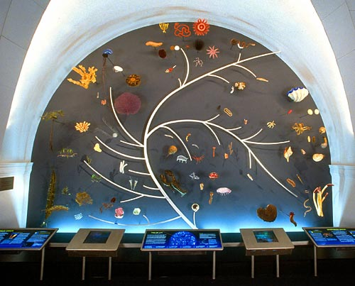
Evolution Notes
Chapter 15

Slide 2
Before Darwin people thought:
Species were unchanging
Different species were not related
The earth was only a couple thousand years old

Slide 3
Until……

Slide 4
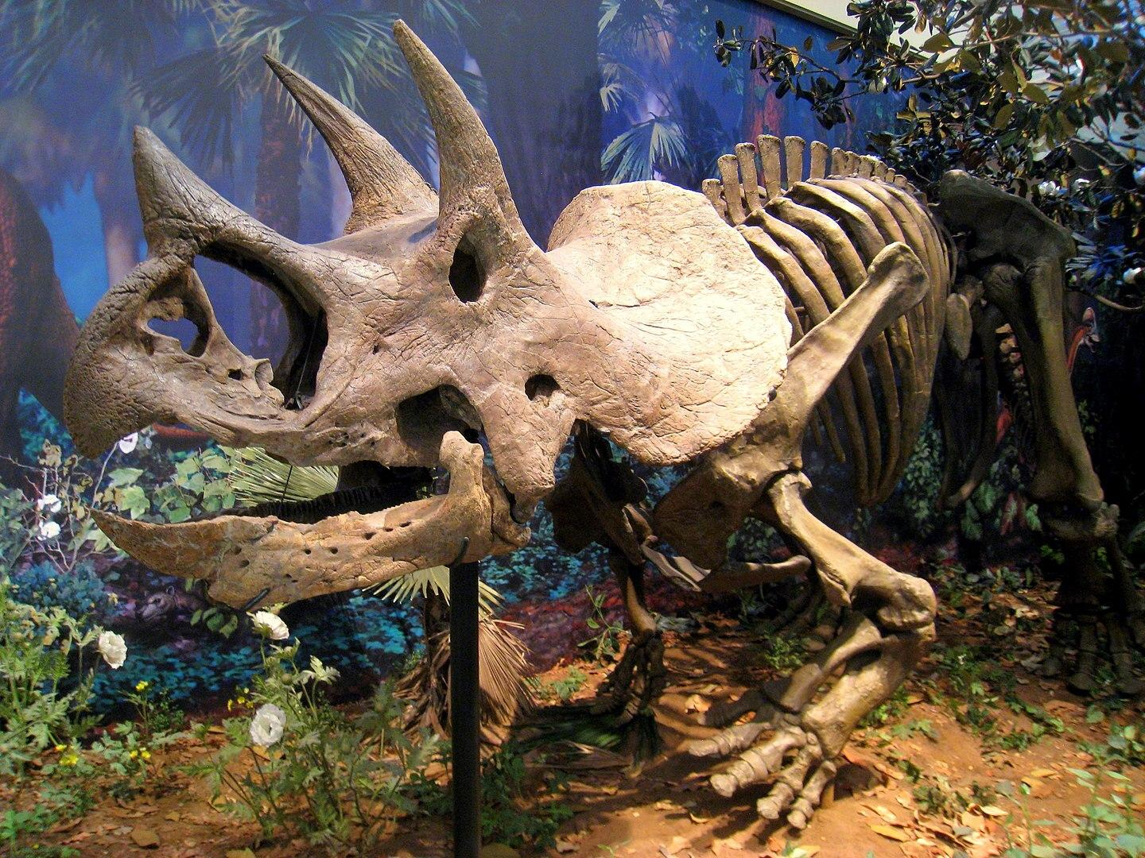
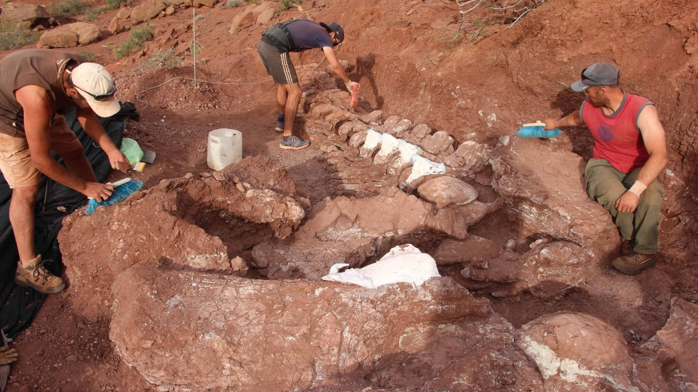
Fossils of extinct species were discovered

Slide 5
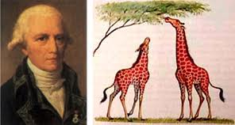
Lamarck
French Naturalist (Biologist)
Lived from 1744-1829
Proposed first Theory of Evolution

Slide 6
Lamarck’s Observations
Species have changed over time
all species had descended from other species
organisms were adapted to their environments

Slide 7
Lamarck’s Evolution Hypothesis
Organisms acquired features that helped them live more successfully in their environment
“Tendency Toward Perfection”
2) If animal altered its body during its lifetime, it would pass on the changes to its offspring

Slide 8
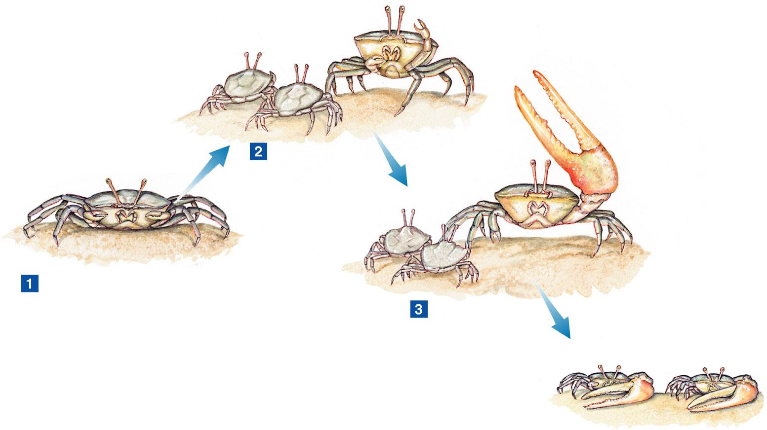
Use and Disuse
Use or disuse of an organ led to change in the organ that was passed on to offspring

Slide 9
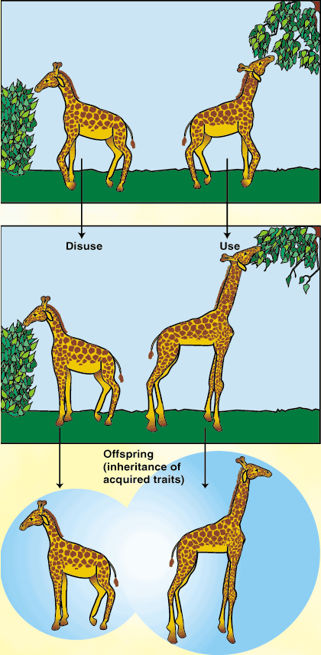
Example: a giraffe that stretched its neck
to reach high leaves would pass this long-necked
trait on to its offspring.

Slide 10
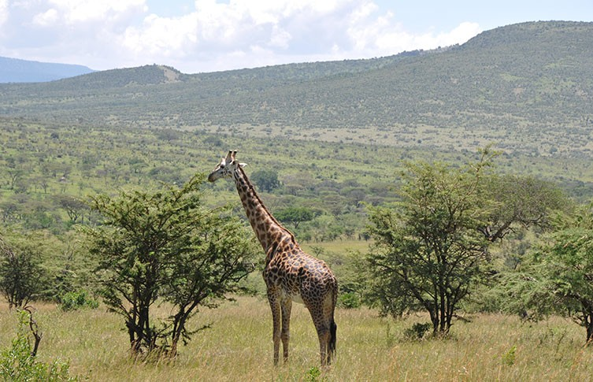
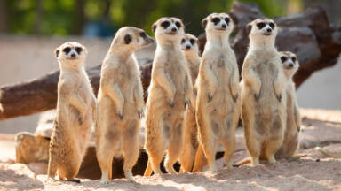
W hat Lamarck Got Correct
He was first to realize that organisms adapted to their environment

Slide 11
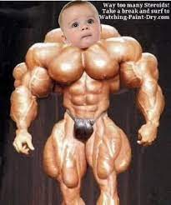
W hat Lamarck Got Wrong
Organism’s behavior has no effect on what it passes on to its offspring
DNA determines that!!!!

Slide 12
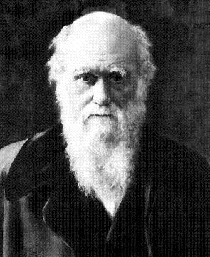
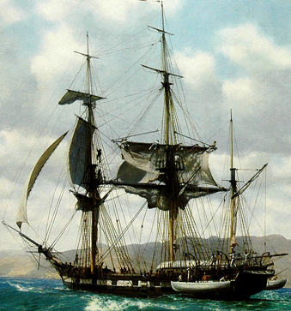
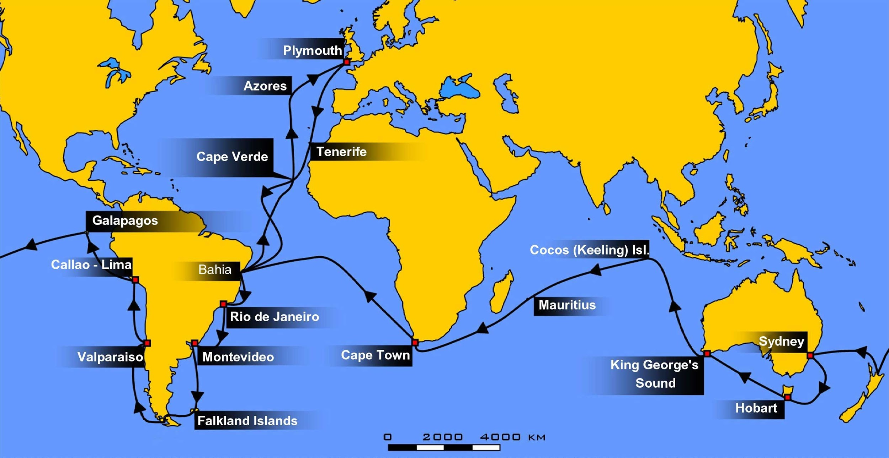
Voyage of the Beagle
-Darwin sailed around the world in the H.M.S Beagle from 1831 to 1836
-made observations and collected evidence that led to theory of evolution

Slide 13
Darwin saw lots of fossils from extinct organisms
Fossils- preserved remains of ancient organisms
Some fossils looked like organisms Darwin was familiar with, some did not
Why had so many of the unfamiliar species disappeared?

Slide 14
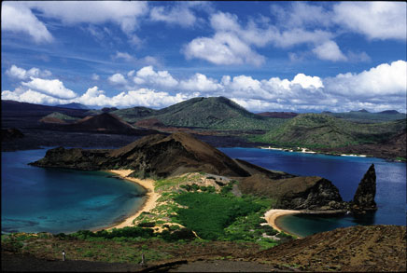
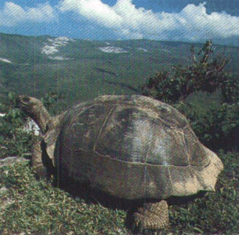
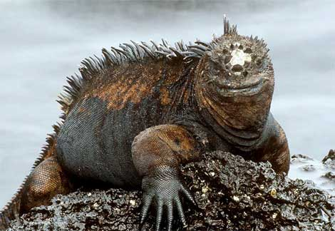
The Galapagos Islands- Darwin’s most famous stop
Small islands west of South America
Have variable climates and diverse animal life
Darwin was interested in the land tortoise and marine iguanas

Slide 15
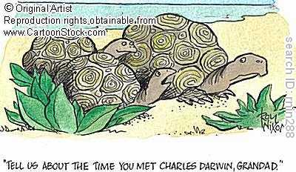
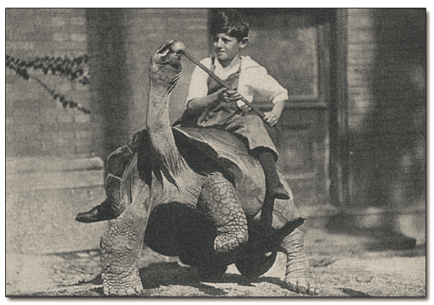
Darwin’s Observations of Galapagos Islands Tortoises
Turtles on different islands had different shell shapes
Turtles with short necks were on rainy islands with lush vegetation

Slide 16
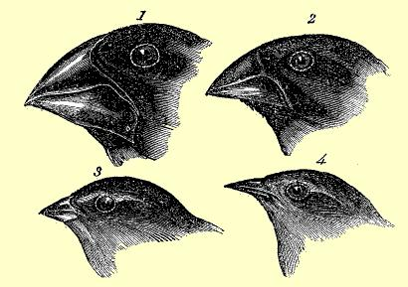
Darwin’s Finches
Birds looked the same, except for their beaks
Had they all come from 1 mainland ancestor?

Slide 17
Darwin Read Lyell’s Principles of Geology
The Earth was much older than once thought- millions of years old
Earthquakes could have raised marine organism fossils from the sea floor to the mountaintop
made Darwin question whether life changed the way the Earth had

Slide 18
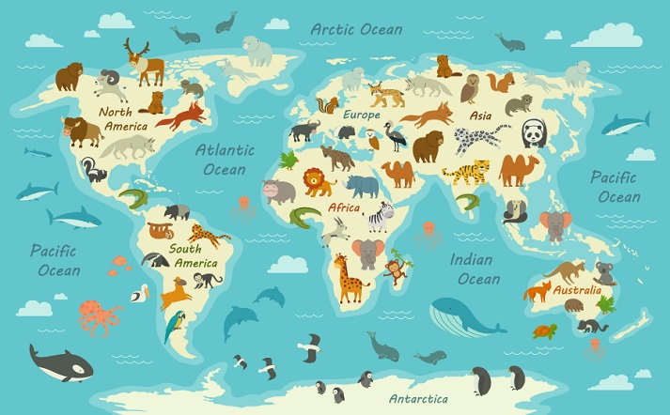
Darwin’s Other Observations
Each of the world’s continents has its own distinctive collection of animals and plants.

Slide 19
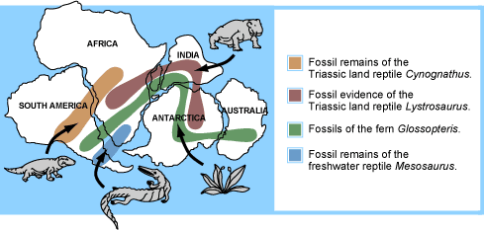
Biogeography
the study of the geographical distribution of organisms

Slide 20
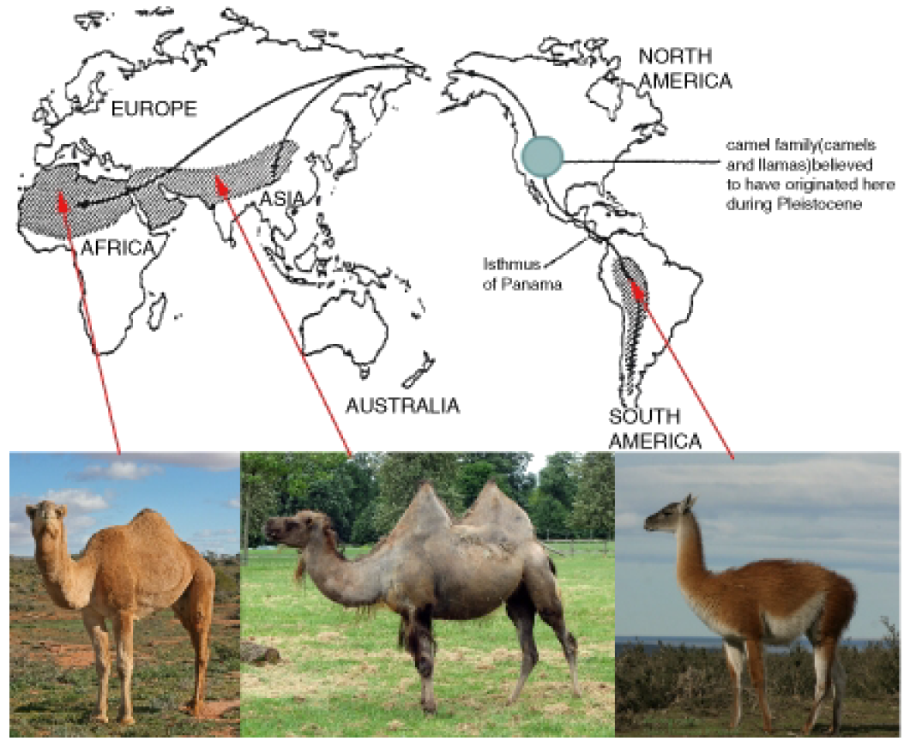

Slide 21
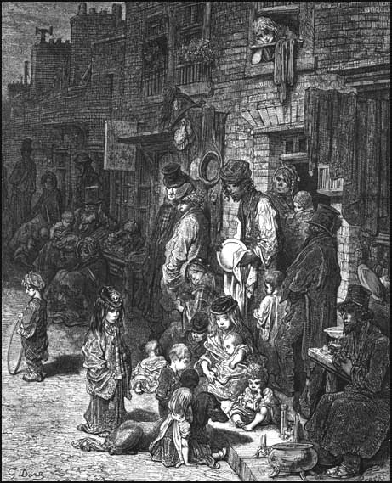
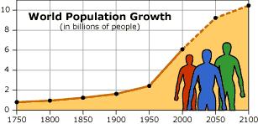
Malthus
Economist
suggested that living space
and food would run out if the human
population continued to grow

Slide 22
Darwin applied Malthus’ theories to nature
Overwhelming majority of species’ offspring die
Darwin wondered what determined which offspring die and which succeed.

Slide 23
Artificial Selection
Breeders noticed that plants and animals of the same species sometimes had small differences
“Inherited variation”
Example: larger fruit, faster horses, cows that produced more milk
Breeders selected these organisms for breeding to keep these desirable traits
“artificial selection”
Nature provided the variation, humans provided the selection

Slide 24
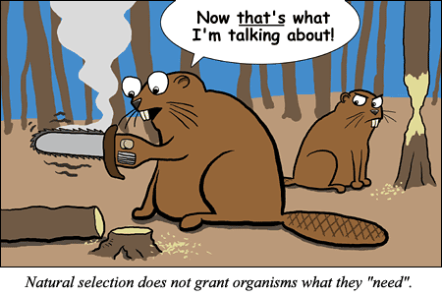
Natural Selection
Organisms with traits well-suited
to their environment survive to
reproduce

Slide 25
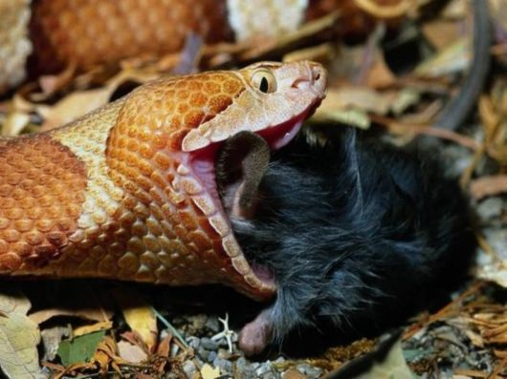
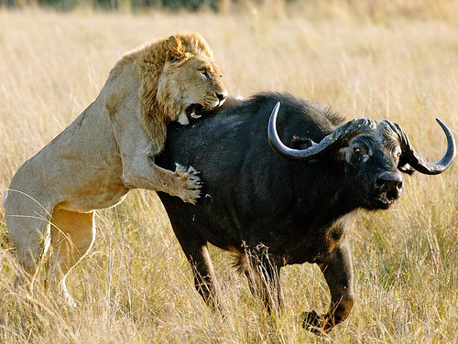
The Struggle for Existence
Members of each species compete for food, living space, etc.
Examples: predators that are faster get more food, prey that is faster or better camouflaged survives

Slide 26
Survival of the Fittest
Fitness- the ability of an organism to survive and reproduce in its specific environment
Adaptation- any inherited characteristic that increases an organism’s chance of survival
**Individuals with adaptations that improve fitness are able to survive and mate

Slide 28
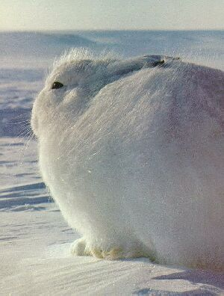
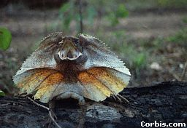
Result of Natural Selection
Over time, successful adaptations are selected for and the inherited characteristics of a population changes
Increase species’ fitness in its
environment

Slide 30
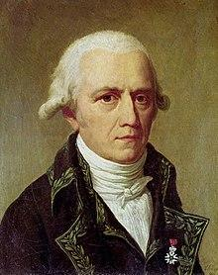
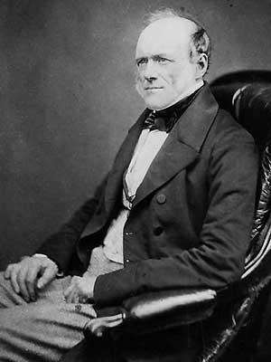
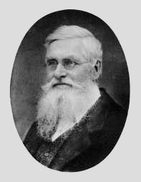
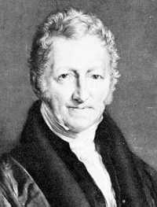
Scientists that influenced Darwin
Lamarck
Lyell
Malthus
Wallace

Slide 31
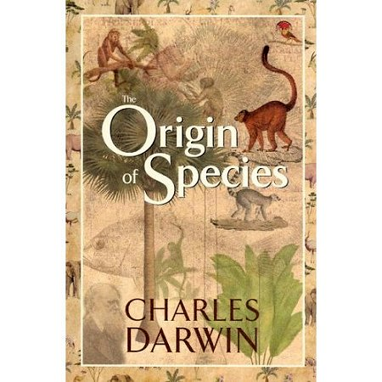
On the Origin of Species
Darwin’s book
Published in 1859
Proposed that the mechanism for evolution was “natural selection”
Controversial

Slide 32
4 Major Points in Darwin’s Book
1) Inherited variation exists within the genes of every species.
2) In a particular environment, some individuals are better suited to survive and have more offspring.
3) Over time, traits that make an individual more likely to survive spread in that population.
4) Fossil evidence suggests that living species evolved from species that are extinct.

Slide 34
Natural Selection Types
Directional selection
Stabilizing selection
Disruptive selection

Slide 35
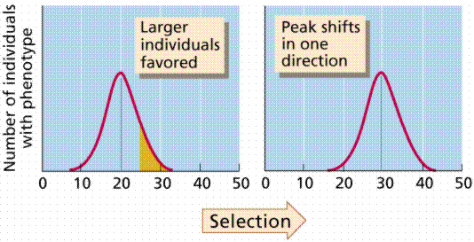
Directional Selection
event such as a food shortage selects for organisms that have a specific trait different than those of most of the population
Example: The environment created a selection pressure which favored giraffes with longer necks who could reach more food in the trees.

Slide 36
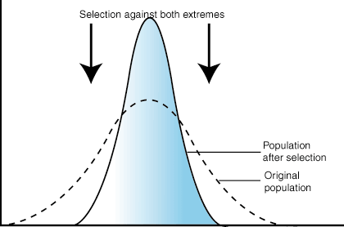
Stabilizing Selection
selects for individuals with the same traits as most of the population
Example: Human birth weight- babies of average weight have the best survival outcomes.

Slide 37
Disruptive Selection
selection is against the “average organisms” in the population and results in 2 separate phenotypes

Slide 38
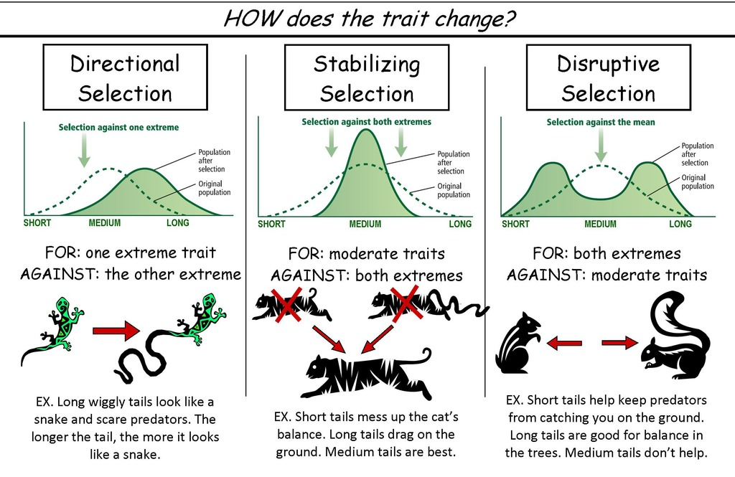

Slide 39
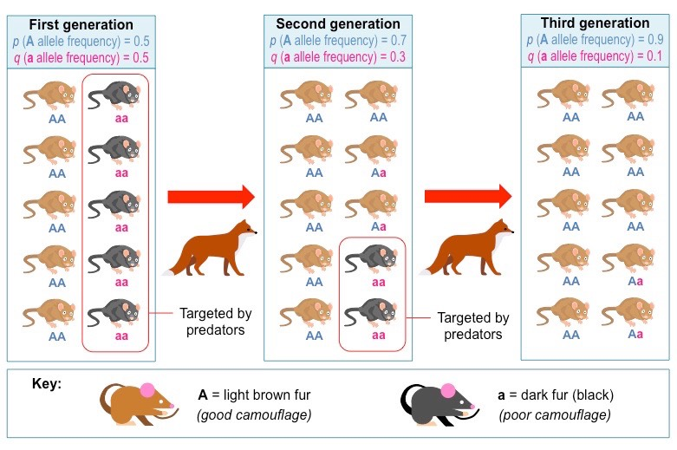

Slide 40
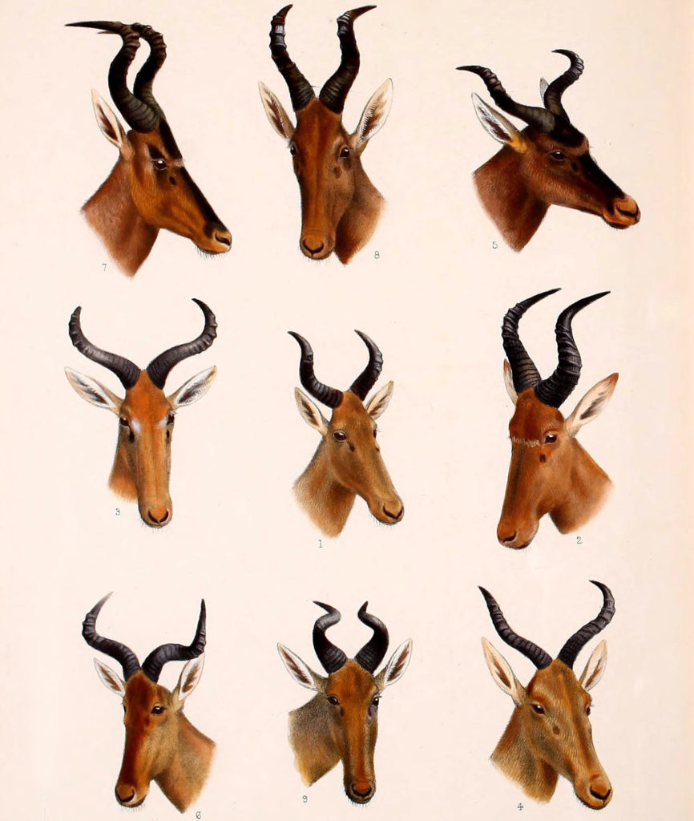
Subspecies
Populations of the same species that differ genetically because of adaptations to different living conditions.

Slide 41
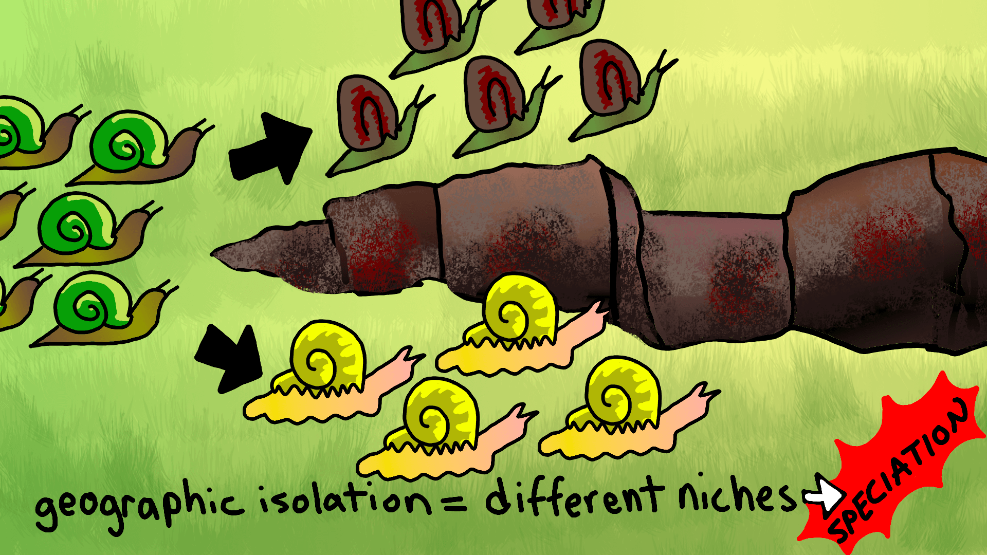
Reproductive Isolation
-2 populations of the same species are separated by a geographic or other barrier and become so different they lose the ability to breed with one another.

Slide 42
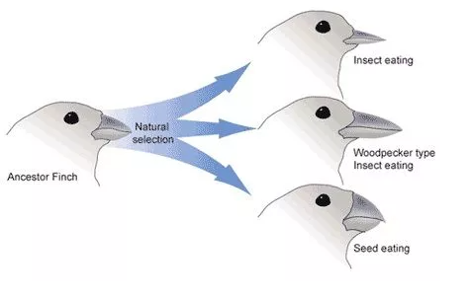
Speciation
process by which new species form

Slide 43
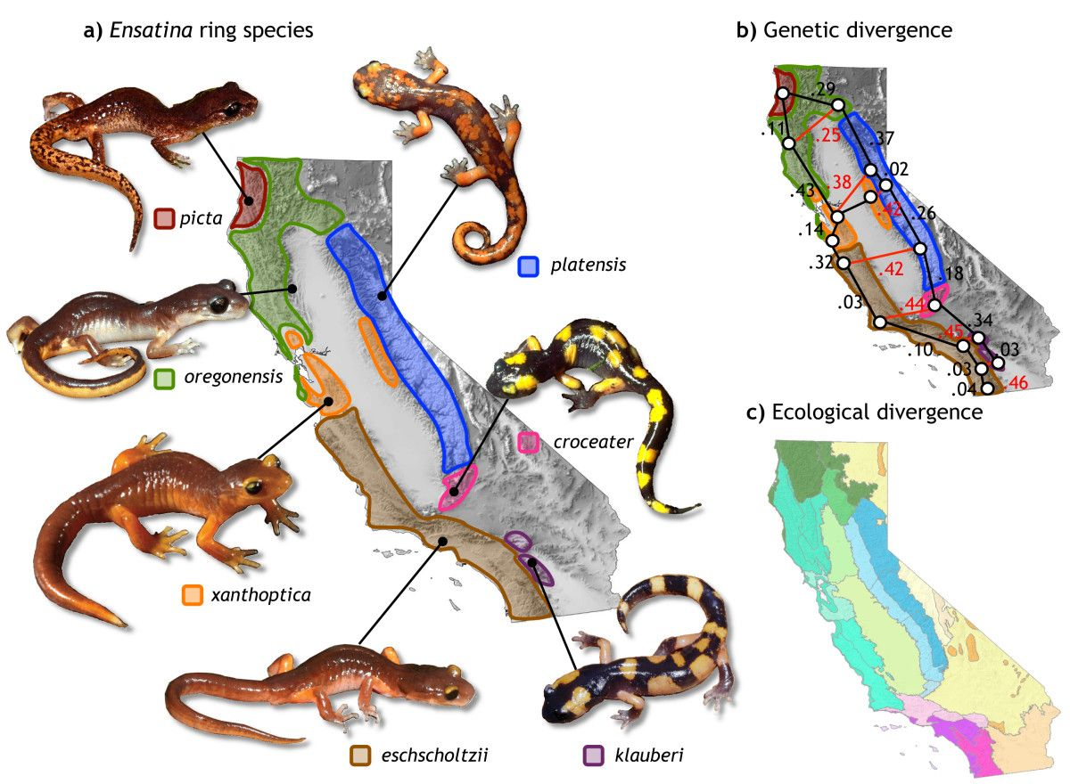

Slide 44
Evolution can be fast or slow
Gradualism- model of evolution in which gradual change over a long period of time leads to species formulation
Punctuated equilibrium- model of evolution in which periods of rapid change in species are separated by periods of little or no change.

Slide 45
Evidence of Evolution
13-2

Slide 46
Evidence of Evolution
The fossil record
Geographic Distribution of Living Species
Body Structure
Embryology
Biological Molecule Similarities

Slide 47
The Fossil Record
Transitional fossils were found for intermediate stages between ancient and modern species

Slide 48
Dinosaurs are the ancestors of birds

Slide 49
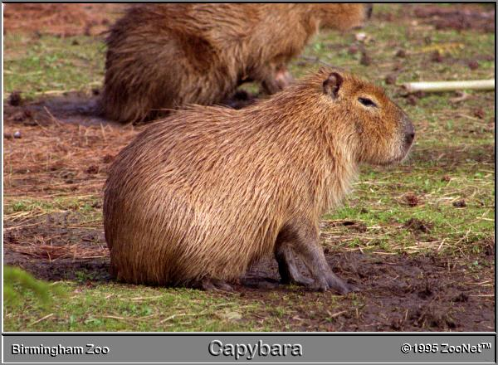
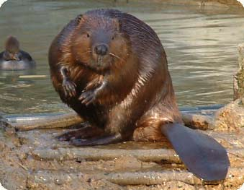
Geographic Distribution of Living Species
Similar species living in different locations were descended from different ancestors
Ex. beaver in North America and copybara in South America have similar characteristics
Similarities exist because they were exposed to same natural selection pressures

Slide 50
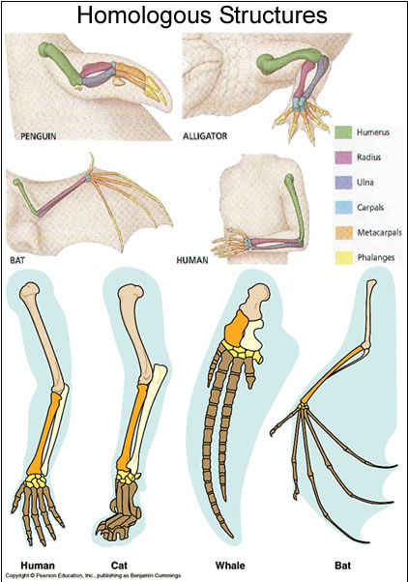
Homologous Body Structures
Structures that have different mature forms but have developed from the same embryonic tissues
Examples: wings of bats and arms of humans
Studying similarities and differences of homologous structures provides clues to ancestry

Slide 51
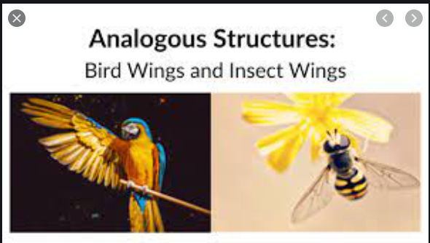
Analogous Structures
- Structures that are similar in function but not necessarily in shape and which do not come from a common ancestor.
Example: Bat wings and insects

Slide 52
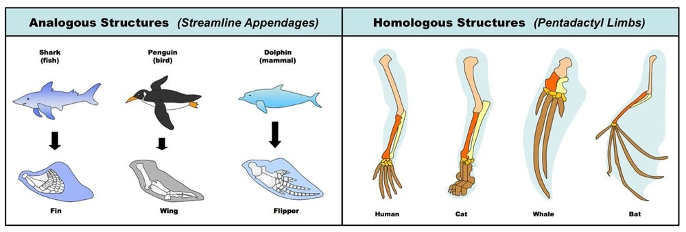

Slide 53
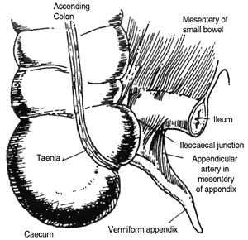
Vestigial Organs
Organs that are traces of homologous organs from other species
Resemble miniature limbs, tails, or other structures

Slide 54
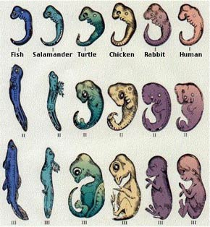
Similarities in Embryology
Early stages of animals with backbones are very similar

Slide 55
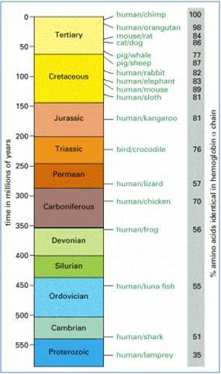
Similarities in Protein Structure
Hemoglobin- protein that makes our blood red
The more similarities between the hemoglobin of 2 species, the more closely related they are

Slide 56
DNA Sequence Similarity

Slide 57
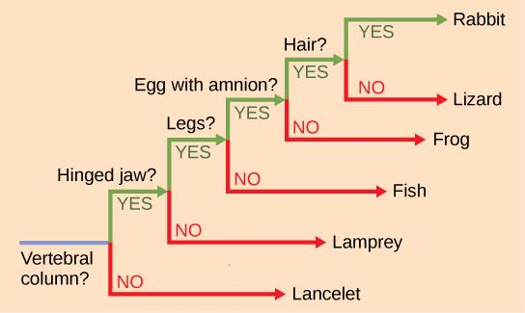

Slide 58
Cladogram

