Slide 1
Water

Slide 2
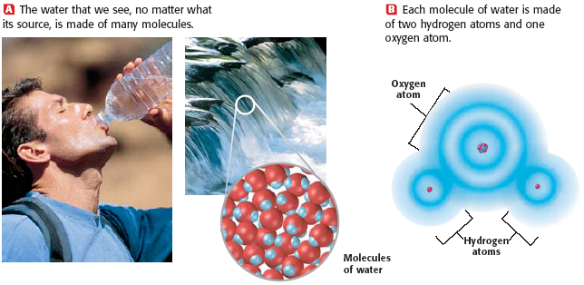

Slide 3
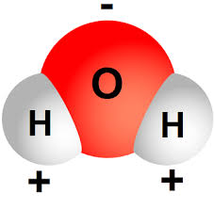
Water is polar because the oxygen and hydrogen share electrons UNEQUALLY
Polar molecules- have a positive end and a negative end
Non polar molecules- have no partial charges
Example- oil
Polar molecules are attracted to other polar molecules!!!
Oil and water don’t mix!

Slide 4
Charges in a Water Molecule

Slide 5
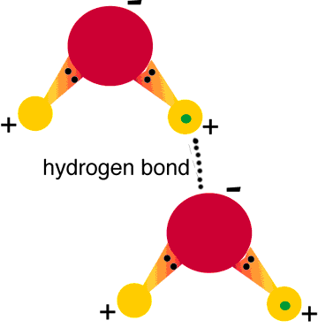
Hydrogen Bonding- a weak bond that attaches one water molecule to another water molecule
Oxygen has a partial negative charge and
hydrogen has a partial positive charge

Slide 6
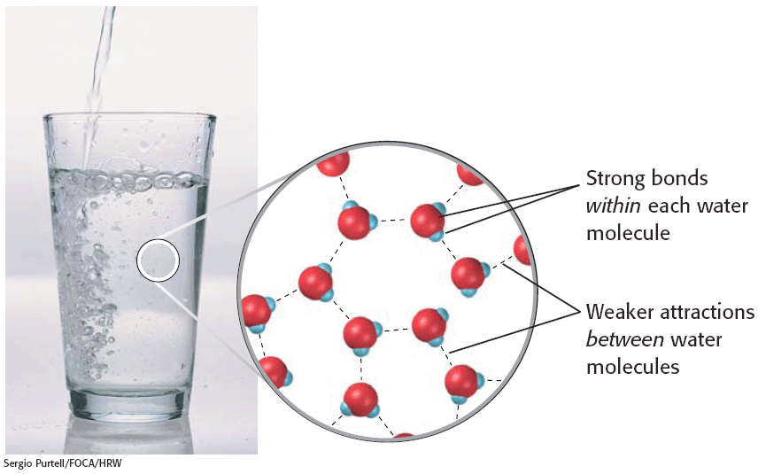

Slide 7
Hydrogen Bonding causes water’s properties
Cohesion
Adhesion

Slide 8
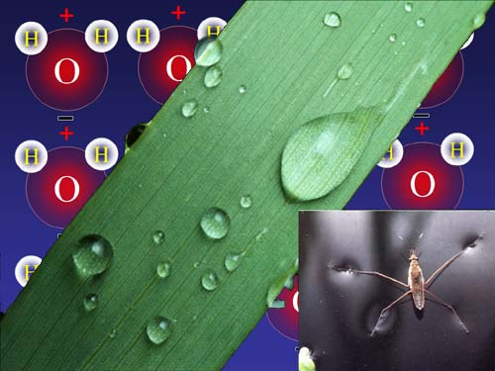
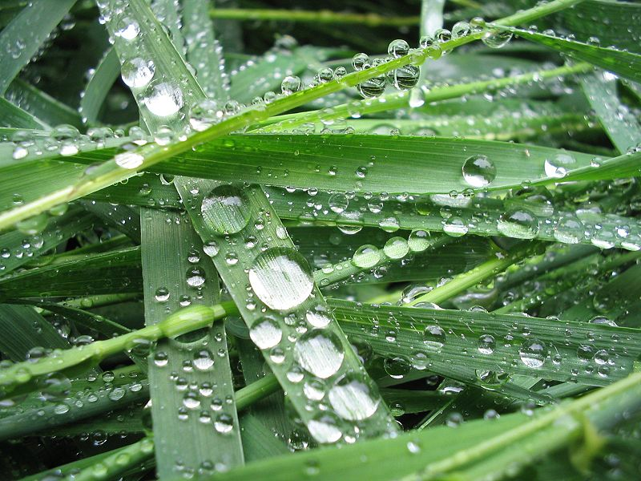
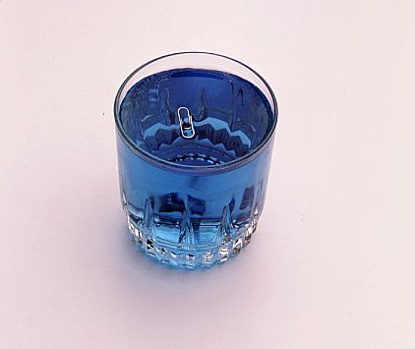
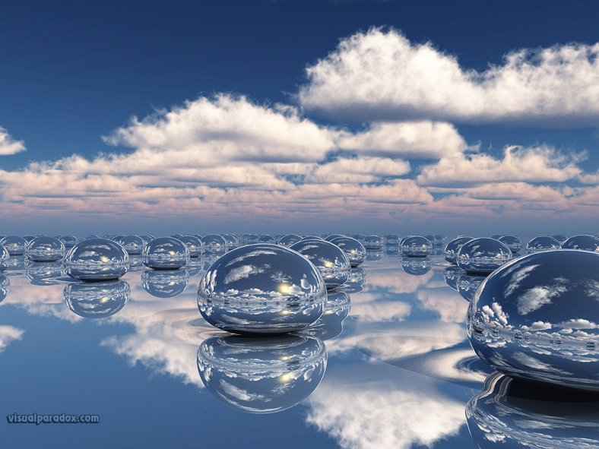
Cohesion-attraction between molecules of the same substance example- surface tension

Slide 9
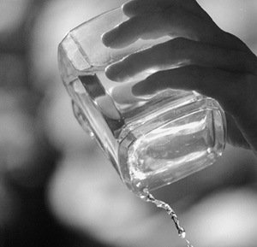
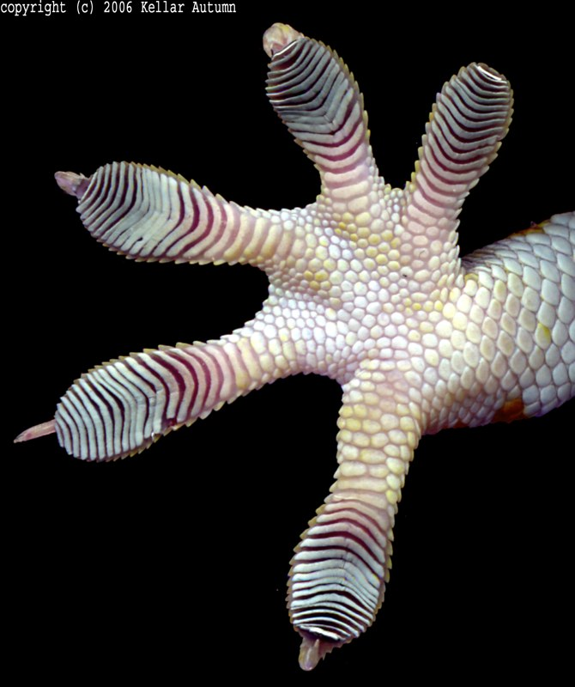
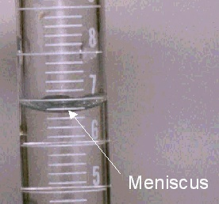
Adhesion
Adhesion-attraction between molecules
of different substances

Slide 10
Mixture
2 or more substances physically combined

Slide 11
Types of Mixtures
Solution
Suspension

Slide 12
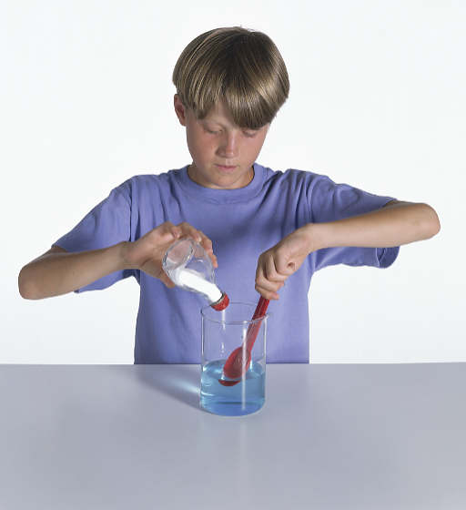
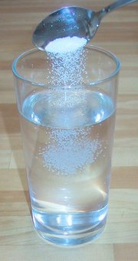
Solution- mixture where components are completely dissolved

Slide 13
Parts of a Solution
Solvent- substance that does the dissolving
example: water
Solute- substance that is dissolved
Example= sugar

Slide 14
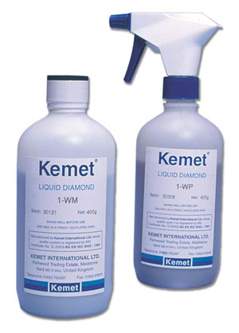
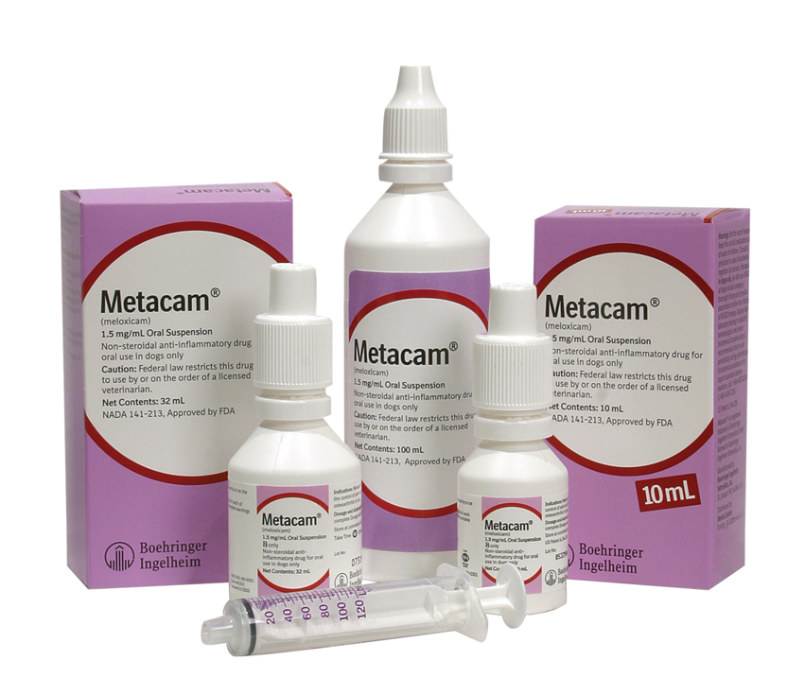
Suspension- mixture where components are not completely dissolved

Slide 15
Acids and Bases

Slide 16
What makes something an acid or a base?
The amount of hydrogen ions it produces!

Slide 17
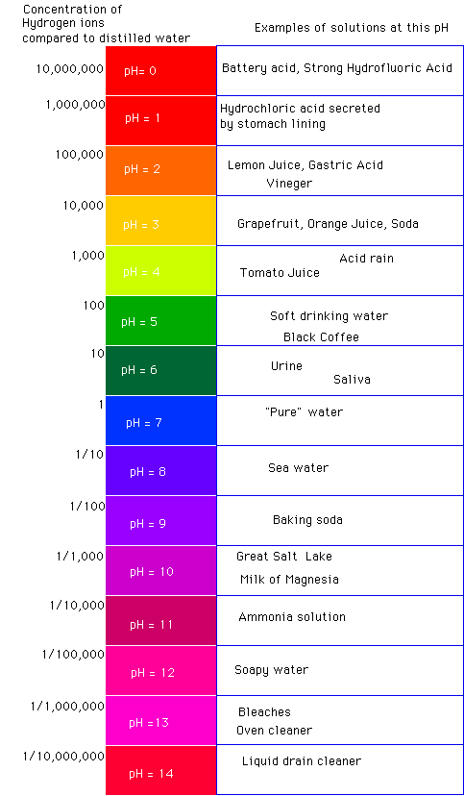
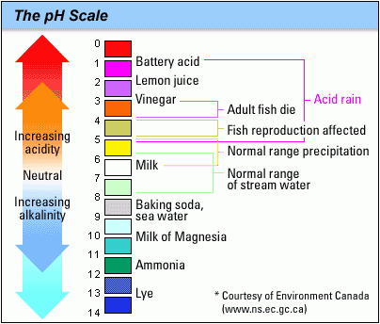
pH Scale- tells how acidic or basic a solution is

Slide 18
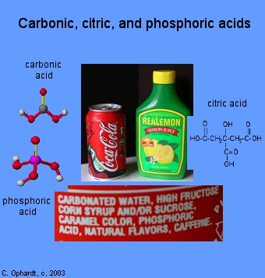
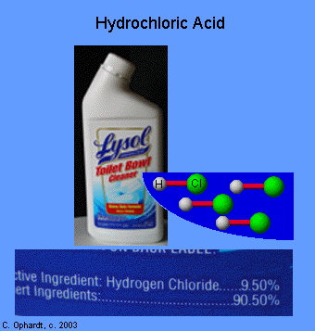
Acid- low pH (0-6), make more hydrogen ions (H+) than bases, taste sour

Slide 19
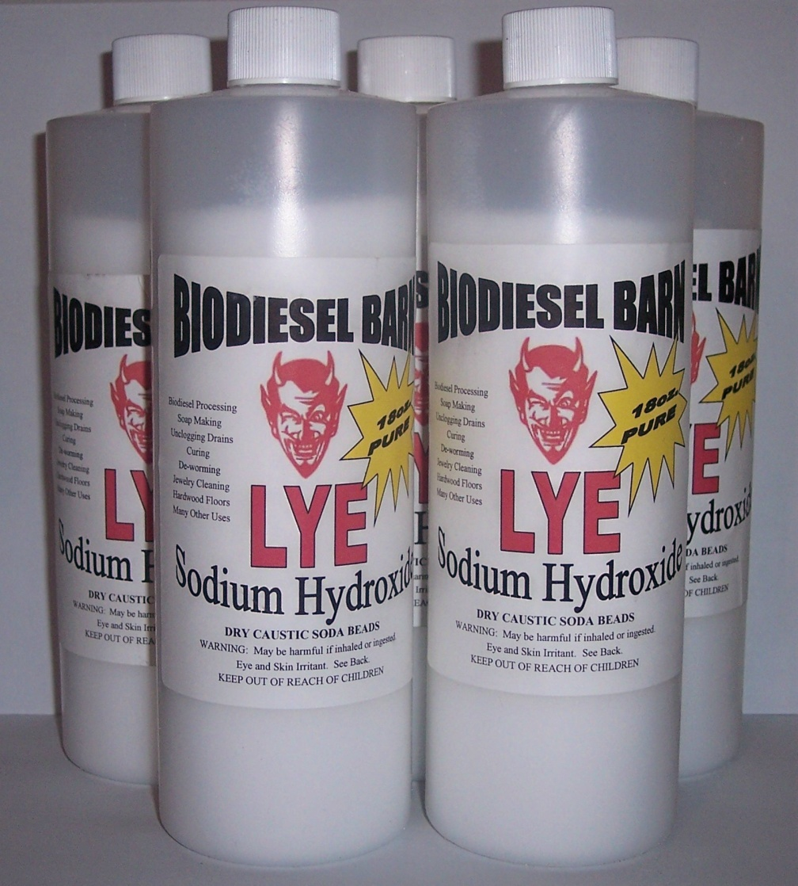
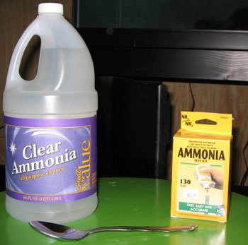
Base- high pH (8-14), make fewer hydrogen ions (H+) than acids, taste bitter

Slide 20
Buffer
Prevent rapid changes in pH
Can be weak acid or base

